Slide 1
Fundamentals of Test Design
Intermediate
Session 1: Fundamentals of Test Design
C3: Protected

Slide 2

About the Author
Created By: | Venkatachalam (119475); Kumaran, Rajeswari (101861); Hema Srinivasan(208178);Ananth Sekar(168314);Malathi D(148178);Poornima Kandasamy(154888);Deepa S (192497);Divya Dhivan(148154)
Credential Information: | 3-14 years of experience
Version and Date: | V 1.0 20-Apr-2011
Cognizant Certified Official Curriculum

Slide 3









Icons Used
Hands on Exercise
Questions
Tools
Coding Standards
Test Your Understanding
Reference
A Welcome Break
Contacts
Try it Out

Slide 4
Fundamentals of Test Design Session 1: Overview
Introduction:
This session will give an overview of various activities carried out during the Test Design phase of STLC.
The various techniques for test design are also detailed out in this course.

Slide 5
Test Design Process - Objective
Objective:
After completing this chapter, you will be able to:
Identify the process involved in Test Development
Define test scenarios
Evaluate the reason for creating the test scenarios
Identify test scenarios
Create test scenarios
Define a Test Case
State the process for creating Test Cases from Test Scenarios
Identify the Test Case Design techniques
Explain test case components
Build test steps
Review Test Cases
Define the need of RTM
Create Traceability Matrix

Slide 6
Test Design Process – Objective (Contd.)
State how to build a RTM
Describe how to maintain a RTM
State the need of Test Runs
List the steps required to build Test Runs
Define the roles of data in testing
List down different test data types
Create Test Data
List procedure for test data preparation
Define Test Data
State the importance of preparing, organizing, and maintaining test data
Identify the problems caused by poor data
Identify the sources of Test Data
Identify the importance of organizing Test Data

Slide 7
Overview of Test Design
The Test Design process involves the following activities:
Obtain the Test Basis (such as requirements, architecture, design, interfaces) for Test Design
Perform functional decomposition of the Requirements
Develop Test Scenarios
Review Test Scenarios
Identify Test Condition
Develop Test Cases for the derived Test Scenarios
Review Test Cases
Prepare Traceability Matrix
Prepare Test Data to support the Test conditions and Test cases
Perform Impact analysis and Identify regression test cases
Create Test Run plan
Obtain Requirement document
Test Scenario
Perform functional decomposition of the Requirements
Create Test Scenarios
Review of the Test Scenarios
Test Condition Identification
Test Development
Test Case Creation/Updates
Review of the Test Case
Test Data Preparation
Impact Analysis
Preparation of Traceability Matrix
Identification of regression test cases
Create Test Run Plan
Fig: Test Design Process
Notes:
Test Basis:
The test basis is the information needed in order to start the test analysis and create test cases. There may be a well written and detailed specification document that we can start with. Ideally we may get a document describing all use cases including their preconditions, basic flow and exceptions. But not always we will get these much documents. There might as well be lots of different documents, all contradicting each other. In some cases there's even no specification document at all. We might get only an old version of the application which need to be explored to learn the functionality. Possible test basis are: Requirements
Functional design
Technical design
User manual
Use cases
Functional Decomposition of Requirements:
1. Decompose the Requirements into one or more statements indicating the conditions that need to be set up and tested.
2. Setting up of conditions to account for the interaction between requirements.
Performing the Functional Decomposition of the requirements into simple statements will be helpful for deriving Test Scenarios

Slide 8
Test Scenario

Slide 9
Overview of Test Scenarios
Test Scenarios are:
Based on realistic events that happen during the actual usage of the application
Hypothetical stories that are:
Motivating - A stakeholder would push to fix a program that failed this test
Credible - It not only could happen in the real world, but stakeholders would believe that something like it probably will happen
Involves a complex use of the program or environment or set of data
Test Results are easy to evaluate
Used to create a clear and simple flow of a complex problem or system
Used to cover a specific functional area, business process, or use case
Testable Business Scenarios, that can be translated to test cases during the Test Development phases

Slide 10
Why Test Scenarios?
Test scenarios perform the following functions:
Bridge Requirement Analysis and Test Development
Ease the process of understanding the product or application under test
Aid in Requirement Elicitation
Help in ensuring test coverage
Help in identifying defects which might go undetected during execution of separate test cases because they tend to use the applications in the same sequence as it would be used in the real world
Test scenarios aids the following:
Identifying Testable Requirements
Identifying business scenarios
Allowing ease of review by SMEs

Slide 11
Test Scenarios - Example
Requirement:
In an invoice approving system, if the maintenance engineer submits invoices with amount >= $500, it should be sent to manager for approval. All invoices with amount < $500 will get auto approved. Manager can also reject invoices if there are any mistakes, which can further be modified by the maintenance engineer and submitted again for approval.
Scenarios:
User submits invoice, amt > $500 dollars, approver approves it
User submits invoice, amt < $500 dollars, invoice gets auto approved
User submits invoice, amt > $500, approver rejects it
User submits invoice, amt > $500, approver rejects it, user submits after modifying to another value which is > $500, approver approves it
User submits invoice, amt > $500, approver rejects it, user submits after modifying to another value which is < $500, invoice gets auto approved
In this example, auto approval may function correctly when the user submits the invoice for the first time with < $500, but may not function correctly when the invoice is rejected and then the user changes the amount to < $500.
Notes:
Only real time scenarios like the last one would uncover such defects. Power of the test scenarios is the flexibility it gives to the tester to play various what-if scenarios and verify how the application behaves.

Slide 12
Types of Test Scenarios
Test scenarios can be categorized based on the flow.
Basic flow - Scenarios aimed to ensure that the application attains it’s prime objective or function. This also covers the Scenarios aimed at showing how the application does not do what it is not supposed to do.
Alternate flow - Scenarios generated to achieve the goal by following an alternate workflow.
Exception flow - Scenarios generated to test the application behavior under exception conditions.
Few Examples from a Leave Management System are as follows:
A Basic flow: Apply leave by mentioning the valid dates and reason in the Leave Management System.
Another Basic flow: Apply leave for the number of days that exceeds the available days (A check done on the basic flow with invalid data).
Alternate: During the apply leave process the user navigates to check the available leave balance and then returns to complete the apply leave process.
Exception: Apply for leave with a user who is serving notice period.

Slide 13
Importance of Basic Scenario
Written to indicate likely threats which should be countered to ensure that systems have sufficient security, safety, and reliability.
Basic scenarios can also include the scenarios which are aimed to show that the system does not do what it is not supposed to do
The more the number of destructive test scenarios, the better the testing process
A requirement coverage is perfect only when all kinds of Test Scenarios are written for the provided requirements
Example1:
Operation of lift functionality
Basic Scenario with all possibilities: Verification of the functionality of the lift upon pressing the Open button when the lift is moving.
Example 2:
Withdrawal of cash from ATM
Basic Scenario with all the possibilities: Withdrawal of an amount which exceeds the balance in the account.

Slide 14
Test Scenarios - Example
Requirements for the leave management system:
All employees should be able to apply for vacation leave, sick leave, compensatory off, and loss of pay. Vacation leave and sick leave can be availed only if there is sufficient leave balance accrued by the employee.
An employee is eligible to accrue one day of sick leave and two days of vacation leave per month. During the month of joining the employee is eligible for the following:
Full month leave accrual if the employee has joined before 10th of the month,
Half the leave accrual if the employee has joined between 10th and 20th of the month
No leave accrual if joining date is beyond 20th of the month
An employee should have worked for a minimum of six hours on a holiday, as per the working hours logged in the timesheet system, to avail a compensatory off.
An employee cannot combine sick leave with any other type of leave except loss of pay. Vacation leave can be combined with compensatory off.
A manager can approve or reject all types of leave.
A user can cancel or modify the applied leave before approval by the manager.
If an employee has availed loss of pay during a month, the salary of the employee for that month will be calculated based on the number of days the employee was on loss of pay.
A user is not allowed to avail any kind of leave while serving the notice period.

Slide 15
Test Scenarios – Example (Contd.)
Following are the scenarios identified for the leave management system:
SCN01: User applies for leave by providing valid dates and number of days
SCN02: User applies for leave with days which are more than the accrued leave
SCN03: User applies for leave and then cancels it before approval
SCN04: User applies for leave and then modifies it before approval
SCN05: User applies combining two types of leave which are valid
SCN06: User applies combining two types of leave which are not valid
SCN07: Manager approves leave applied by the employee
SCN08: Manager rejects leave applied by the employee
SCN09: User applies for loss of pay. Manager approves leave. Salary in payroll system is calculated based on the number of days applied.
SCN10: User is allowed to apply for compensatory off based on the hours worked from the timesheet system.
SCN11: Leave accrual for a user who has joined during the second month of a year
SCN12: User serving the notice period applies for leave

Slide 16
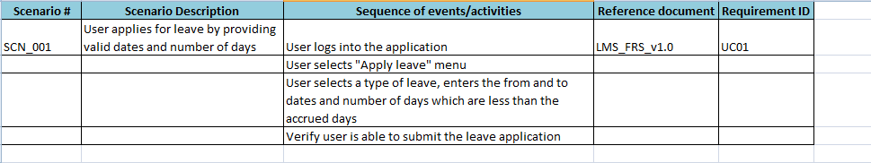
Contents of Test Scenarios
Following are the components of Test Scenarios:
Scenario #
Scenario Description
Sequence of events/activities
Reference document
Requirement ID/Use case name
Fig: Sample Test Scenario Template

Slide 17
Requirement Traceability Matrix
A traceability matrix is a document, usually in the form of a table. It correlates any two base lined documents that require a many to many relationship to determine the completeness of the relationship. It is often used with high-level requirements and detailed requirements of the software product to the matching parts of high-level design, detailed design, test plan, test scenario, and test cases.
The tracking of the link between the requirement and the test scenario is frequently done using a traceability matrix.
To ease the creation of traceability matrices, relationships are added to the source documents for both backward traceability and forward traceability. In other words, when an item is changed in one base lined document, it is easy to see what needs to be changed in the other.

Slide 18
Requirement Traceability Matrix (Contd.)
Sample Traceability Matrix:
Forward Traceability Matrix:
Backward Traceability Matrix:
Requirement # | Requirement Description | Test Scenario #
a | All employees should be able to apply for vacation leave, sick leave, compensatory off, and loss of pay. | SCN01
b | An employee is eligible to accrue one day of sick leave and two days of vacation leave per month. | SCN01, SCN02, SCN11
Test Scenario # | Test Scenario Description | Requirement #
SCN01 | User applies for leave by providing valid dates and number of days | a, b
SCN02 | User applies for leave with days which are more than the accrued leave | b
SCN11 | Leave accrual for a user who has joined during the second month of a year | b

Slide 19
Requirement Traceability Matrix (Contd.)
Following are the benefits of a Requirement Traceability Matrix:
Used to ensure design coverage. Makes sure every requirement is covered by at least one test scenario and test case (after test case development)
Useful to track defects back to requirements, which would be useful in identification of regression test scenarios and test cases.
Useful for impact analysis. If there is a change in a requirement, it is easy to identify the test scenarios/cases which have to be changed in line with the requirement change.
Backward traceability matrix ensures that just enough test scenarios/cases are written and that they are not redundant

Slide 20
System Testing and System Integration Test Scenarios
Test scenarios should be identified for both system and system integration testing.
Definition of system and system integration testing (recap):
System testing: This is the testing conducted on a complete, integrated system to evaluate the system's compliance with its specified requirements. System testing falls within the scope of black box testing. It does not require any knowledge of the inner design of the code or logic.
System Integration Testing (SIT): This is the testing performed when two systems, generally presumed stable themselves, are integrated with one another. The goal of systems integration testing is to ensure that the data is crossing the boundary.

Slide 21
Test Scenario - Sample Scenario for System Testing
In the LMS system described earlier, all the following scenarios are within the bounds of the LMS system and hence system test scenarios:
SCN01: User applies for leave by providing valid dates and number of days
SCN02: User applies for leave with days which are more than the accrued leave
SCN03: User applies for leave and then cancels it before approval
SCN04: User applies for leave and then modifies it before approval
SCN05: User applies combining two types of leave which are valid
SCN06: User applies combining two types of leave which are not valid
SCN07: Manager approves leave applied by the employee
SCN08: Manager rejects leave applied by the employee

Slide 22
Test Scenario - Sample Scenario for System Integration Testing
In the LMS system, all the following scenarios require integration of LMS with external systems and hence are system integration test scenarios.
SCN09: User applies for loss of pay. Manager approves leave. Salary in payroll system is calculated based on the number of days applied.
For this scenario, the data of days on loss of pay from leave management system should be ported to the payroll system.
SCN10: User is allowed to apply for compensatory off based on the hours worked from the timesheet system.
For this scenario, the data of the day and hours worked should be ported from the timesheet system.
SCN11: Leave accrual for a user who has joined during the second month of a year.
For this scenario, the date of joining of the employee from the employee master database should be ported to the leave management
SCN12: User serving the notice period applies for leave.
For this scenario, the date of last working day and the notice period term should be ported from the employee master database.
Payroll System
Leave Management System
Timesheet System
Employee Master Database

Slide 23
Test Scenario Design Techniques
Tools
Test Scenarios could be generated using the following techniques:
Use Case Modeling
Activity Component Element

Slide 24
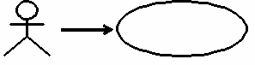
Use Case: Introduction
Tools
A use case defines a goal-oriented set of interactions between external actors and the system under consideration.
Use cases address all functional requirements.
It is written from a user perspective.
It includes story of interactions between actors and system.
Use cases capture who (actor) does what (interaction) with the system, for what purpose (goal), without dealing with system internals. A complete set of use cases specifies all the different ways to use the system, therefore defining all the behavior required of the system and bounding the scope of the system.
Actor Process
Fig: Use Case Model

Slide 25
Components of Use Cases
Tools
Use Case includes the following variants of sequence:
Basic Flow sequence to satisfy the goal
Alternative sequences that may also satisfy the goal
Sequences that may lead to failure in completing the service because of exceptional behavior, error handling, and so on

Slide 26
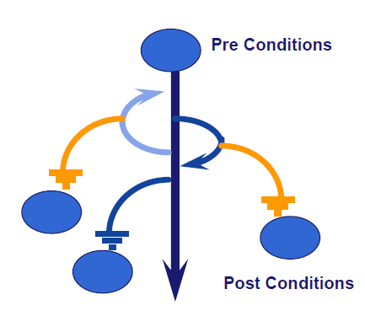
Components of Use Cases (Contd.)
Tools
The components of Use Cases can be categorized as follows:
Primary Flow
Alternate flows
Triggers/Activities
Exception Flows
Pre Conditions – These are conditions that need to be set for performing the activity to achieve the goal
Post Conditions – These are the conditions that need to be verified by the tester after the activity is performed

Slide 27
Components of Use Cases
Tools
Example: Ordering a meal in the restaurant
Primary Flow:
Precondition 1 : The customer should be present in the restaurant
Precondition 2 : The waiter gets the menu card for the customer
Activity : The customer places the order to the waiter
Post Condition : The waiter delivers the food and the customer pays for the food
Alternate Flow for placing a meal order in the restaurant
Precondition 1 : The customer should be present in the restaurant
Precondition 2 : The waiter gets the menu card for the customer
Activity 1 : The customer places the order to the waiter
Activity 2 : The waiter checks and informs that the ordered item is not available
Activity 3 : The customer places an other order
Post Condition : The waiter delivers the food and the customer pays for the food

Slide 28
Components of Use Cases (Contd.)
Tools
Exception Flow for placing a meal order in the restaurant
Precondition 1 : The customer should be present in the restaurant
Precondition 2 : The waiter gets the menu card for the customer
Activity 1 : The customer looks through the menu and while placing the order asks the waiter for water
Activity 2 : The waiter pours the water on the customer’s shirt
Activity 3 : The customer gets angry, shouts at the waiter and leaves the restaurant without ordering anything
Post Condition : The customer leaves without placing an order

Slide 29
Use Case Model: Creating Test Scenarios
Test Scenarios ‐ paths through a Use Case
Scenarios describe what an actor can do, using the basic flow and alternate flows from start to finish, through the use case
Alternate flows cannot be tested by themselves. A combination of basic flow and alternate flows will give good test scenarios
There will be many scenarios for any given use case
Each possible combination of main flow and alternate flows
The minimum number of scenarios will be equal to the number of alternate flows plus the main flow

Slide 30
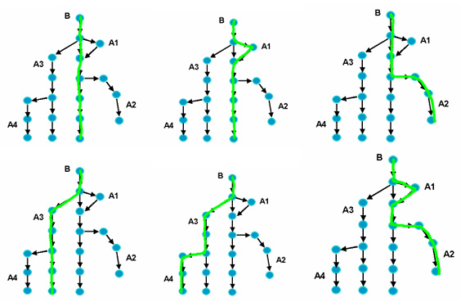
Use Case Model: Creating Test Scenarios (Contd.)
The following flow diagram and table describes the Test Scenarios
 | Main Flow | Alternate Flow | Alternate Flow
Scenario 1 | Basic Flow
Scenario 2 | Basic Flow | Alternate Flow 1
Scenario 3 | Basic Flow | Alternate Flow 2
Scenario 4 | Basic Flow | Alternate Flow 3
Scenario 5 | Basic Flow | Alternate Flow 3 | Alternate Flow 4
Scenario 6 | Basic Flow | Alternate Flow 1 | Alternate Flow 2

Slide 31
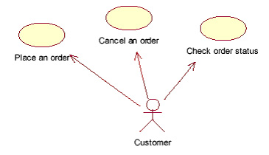
Use Case Model : Test Scenario Creation - Example
E-Commerce Web Site Order Management
Requirement: The system shall allow the user to place an order from the E-Commerce Web Site
Using the use case modeling technique, an use case is generated which covers the various possible flows for checking for the placing the order in the E-Commerce web site

Slide 32
Use Case Model : Test Scenario Creation - Example (Contd.)
Basic flow (with sequence of events) of the use case for the order placement might look like the following:
Alternate Flows of the use case for the order placement might look like the following:
B1 - User enters web site address in the browser → <System displays Website Home page.> | B6 - User adds the selected items to a shopping cart → <Shopping cart contents are presented to the user.>
B2 - Register as a new user with Email (as Login ID) and Password → <System registers the new user details> | B7 - User selects "proceed to checkout" option → <System asks for confirmation of a shipping address.>
B3 - User enters an email address and a password → <System confirms correct login, presents main page, and prompts for a search string.> | B8 - User confirms shipping address → <System presents shipping options.>
B4 - User performs Search in the Catalog, enters search string – partial name of an item → <System returns all items matching search criteria.> | B9 - User selects shipping option → <Systems ask which credit card will be used.>
B5 - User selects an item → <System presents detailed information about the item.> | B10 - User confirms credit card that is stored in the system → <System asks for final confirmation to place an order.>
 | B11- User places the order → <System returns a confirmation number.>
A1 - Unregistered user | A5 - Continue shopping after storing a book in the shopping cart
A2 - Invalid password | A6 - Enter a new address
A3 - No books matching search criteria were found | A7 - Enter a new credit card
A4 - Decline a book | A8 - Cancel order

Slide 33
Use Case Model : Test Scenario Creation - Example (Contd.)
Scenarios that can be tested using the combination of Basic Flow and Alternate Flows are as follows:
SCN # | Scenario Description
SCN-001 | To verify that the system allows the user to place an order from the E-Commerce Web Site
SCN-002 | To verify that the system prevents the unregistered users from login into the E-Commerce Website
SCN-003 | To verify that the system prevents the user from login into the E-Commerce Website with an Invalid Password
SCN-004 | To verify that the system does not display any books matching the search criteria in the Search Catalog and continue the shopping
SCN-005 | To verify that the system allows the user to decline a selected book from adding into the Shopping Cart and continue shopping after declining the book
SCN-006 | To verify that the system allows the user to continuing shopping after storing a book in the Shopping Cart
SCN-007 | To verify that the system allows the user to enter a completely new Shipping address while providing the Shipping info during the Order Placement
SCN-008 | To verify that the system allows the user to enter a completely new Credit Card while providing the Payment info during the Order Placement
SCN-009 | To verify that the system allows the user to cancel an already existing order
SCN-010 | To verify that the system allows the user to enter completely new address and credit card during the Order Placement
SCN-011 | To verify that the system allows the user to enter a completely new Credit Card while providing the Payment info and cancel the Order Placement

Slide 34
Benefits of Use Case Modeling
Tools
Allows testers to write test cases before any code is written
Provides a clear testing methodology
Gives testers a head start in understanding what the application is supposed to do
Helps you know when you are done
Helps to create Test Scenarios with the help of Use Cases

Slide 35
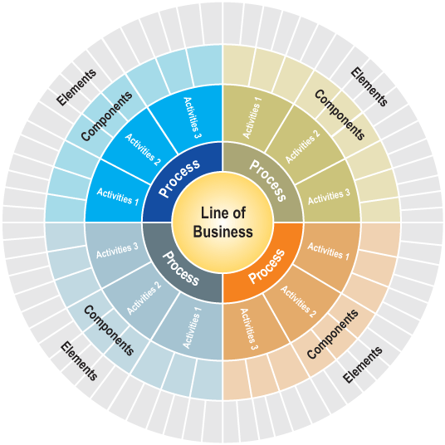
What is ACE?
What is ACE?
Functional Decomposition Model
Activity
Component
Element
Understand the Business Area
Capture the functional use
Business process at multiple levels
Componentization
Drill down to the Business Elements
Understand its implication
Traceability
Hand-shake
Fig: ACE Model

Slide 36
ACE Methodology – Objective and Uses
Objective - ACE (Activity-Component-Element) methodology is a functional decomposition technique which breaks business processes into activities, components, and elements to bring out the underlying functional complexity. This is done by translating business scenarios to reusable set of test scenarios, ensuring coverage and traceability.
ACE can also be used as a training tool to enhance the domain specific knowledge of the testing team.

Slide 37
ACE Methodology
Activities
Component
Element
Component 1
Element 1
RUS*1
Activity 1
RUS*2
Element 2
ACE Methodology
Component 2
Element 3
Activity 2
Element 4
Component 1
Element 1
Component 2
Element 2
Activity 3
Element 3
Component 3
Component 4
Activity 4
Component 5
* RUS – Reusable Scenario

Slide 38
Build Test Scenario Using the ACE Methodology
The requirements are analyzed and business areas are identified
On analyzing the requirement, the scope, and the expectation of testing is derived
Workflow is derived from the analysis of the business process at multiple levels
By analyzing the workflow the re-usable Test Scenario and its description is arrived
Using the re-usable test scenario, basic, alternate, and exceptional flows can be generated which are specific to application

Slide 39
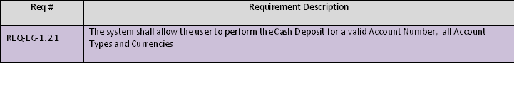
Build Test Scenario Using the ACE Methodology (Contd.)
Example: Teller Application
The provided Requirements are analyzed and driven with workflow

Slide 40
Build Test Scenario Using the ACE Methodology (Contd.)
Fig: ACE Methodology Workflow for Teller System
Activities
Component
Element
Cash Deposit
Account Number
Valid Account Number
Invalid Account Number
ACE Methodology
Account Type
Savings Account
Cash Withdrawal
Account Currency
Checking's Account
Local Currency
Foreign Currency

Slide 41
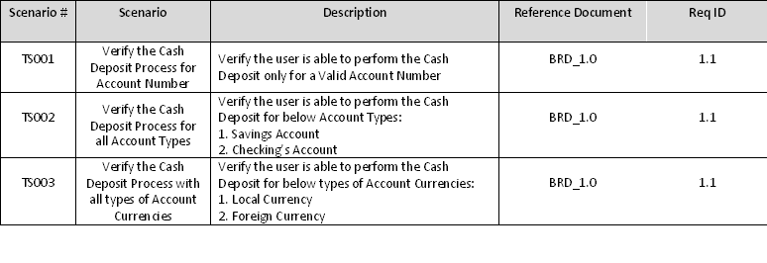
Build Test Scenario Using the ACE Methodology (Contd.)
Sample Test Scenarios developed using the ACE Methodology:

Slide 42
Benefits of ACE Methodology
Following are the uses of ACE Methodology:
Reduced Knowledge Acquisition time
Knowledge Transition to address only the delta that is Application/Geography specific
Advanced test analysis like the critical functionalities can be tracked before hand
Improved domain coverage paving way to addressing the testability at a granular level
Enhanced test design with Test scenarios and Test conditions clearly defined
Easier traceability to the Business Requirement/Functional Specification document
Translates to sanity check on critical functionalities
Facilitates in Testers comprehending the functionalities easily
Can by default be the boot-camp material from a domain and test coverage perspective
Such scenario libraries leads to very high re-usability
A robust regression pack from a functional perspective

Slide 43
Test Development : Test Development Process
Notes:
Enter the course title.
Enter the knowledge level that will be addressed through this course.

Slide 44
Test Development : Test Development Process - Overview
Introduction:
The process of preparation of complete set of test cases to be performed during testing is the Test Development Process. This module provides a detailed description about the various activities involved in test case design like:
Test Development Process
Test Coverage
Building RTM
Test Data Preparation

Slide 45
Test Development Process
Completed Test Scenarios and Test Conditions
Test Design
Traceability Matrix
Update Traceability Matrix with the Test Case details
Perform Traceability Matrix Review
Test Data Preparation
Develop Test Data for the Test Cases
Validate Test Data
Test Case Development
Identify Test Cases for the Test Scenarios
(include all Scenario Types: - Basic, Alternate and Exception) in conjunction with test conditions
Make best use of Test Design Techniques
Boundary Value Analysis
Equivalence Partitioning
Decision Table
Identify inputs, execution pre-conditions and expected outcomes
Use Test Case Syntax and build the Test Steps
Follow Test Case Design Guidelines
Test Development
Test Artifacts Review
Follow Review Checklist
Perform Review and implement all Review Comments
Prepare Test Run Plan
Fig: Test Development process
Notes:
Overview of Test Case Development Process

Slide 46
Test Case Development Process
Test Case is a set of inputs, execution preconditions, and expected outcomes developed for a particular objective, such as to exercise a particular program path or to verify compliance with a specific requirement.
Test case is a one that has a high probability to find an error
Test cases help to discover information
Test cases must be written for the invalid and the unexpected, as well as for valid and expected conditions
Test case should not be redundant and neither too simple nor too complex (more than one expected result)
Test case includes the following elements:
Purpose of the test or description of what requirement is being tested
Method of how it will be tested
Setup to test: version of application under test, hardware, software, operating system, data files, security access, time of day, logical or physical date, prerequisites such as other tests, and any other setup information pertinent to the requirements being tested
Actions and expected results, or inputs and outputs
Any proofs or attachments (optional)

Slide 47
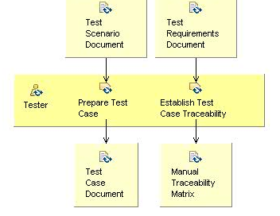
Test Case Development Process (Contd.)
Following are the entry Criteria to Test Case design process:
Freezed (without any further changes) Business processes/Requirement Documentation
Approved Test Scenarios
Approved Standards for Test case documentation
Approved Standards for Test case naming convention
Test Data Source
Input
Process
Output
Fig: Test Case Development Process
Notes:
To start with the preparation of test case, Test requirements and Test scenario document should be in place
Tester designs the test case based on the available documents.
The Exit criteria for test design phase will be “Test Case Document” and “Requirement Traceability Matrix” updated

Slide 48
Test Case Development Process (Contd.)
Following are the steps to arrive at test cases:
From the scenarios, the basic and alternate flows could be considered to write the test cases. Thus, multiple test cases could be generated for a single scenario with multiple test conditions. Both positive and negative test cases can be derived for a single scenario.
Identify test conditions as follows:
For each flow, identify the input variables for each step. Input variables are the parameters that the user provides as input.
Find out the significantly different options for each of the input variables.
Identify the various possible combinations of the above options.
Combine test conditions along with the identified scenarios to be tested into test cases.
Decide on whether to combine or split the test cases for each of the different flows (basic, alternate).

Slide 49
Overview of Test Conditions
Test scenarios are at a higher level and do not ensure coverage of the various permutations and combinations. This gap is addressed by usage of test conditions. Test conditions cover the various permutations and combinations of values to test a feature, thus ensuring coverage at a more granular level.
Following are the steps to arrive at a test condition:
Step 1: Identifying various options
Step 2: Optimize options based on variations in application behavior pertaining to that option

Slide 50
Overview of Test Conditions (Contd.)
Step 1: Identifying various options:
Consider the following requirements of leave management system:
The user should be able to apply for:
Vacation leave
Sick leave
Compensatory leave
Loss of pay
Vacation leave can be taken in continuation to compensatory leave
Sick leave cannot be combined with any other type of leave except loss of pay
The various options of feature (a) and the combinations given in features (b) and (c) are test conditions. These are:
Applying for vacation leave
Applying for sick leave
Applying for compensatory leave
Applying for loss of pay
Applying for vacation leave along with compensatory leave
Applying for vacation leave along with sick leave
Applying for vacation leave along with loss of pay
Applying for compensatory leave along with sick leave
Applying for compensatory leave along with loss of pay
Applying for loss of pay along with sick leave

Slide 51
Overview of Test Conditions (Contd.)
Step 2: Optimize options based on variations in application behavior pertaining to that option:
Of the above options, one and two (applying for vacation leave and applying for sick leave) can be treated as a single test condition since the application pre-requisites and behavior is not different between these two types of leave. That is, both types of leave can be availed only if there is sufficient balance accrued by the employee)
Option three (applying for compensatory leave) is a separate condition since the prerequisite is different for this type of leave, that is, user should have record of working hours during holidays
Option four (applying for loss of pay) is a separate condition since this type of leave does not have the prerequisite of a leave balance accrued
Rest of the options from 5 to 10 are separate conditions since the application behavior varies for each of these combinations that is, it allows some combinations and does not allow the rest.

Slide 52
Overview of Test Conditions (Contd.)
Based on the above optimized options, following are the final set of test conditions are:
C01: Applying for vacation / sick leave
C02: Applying for compensatory leave
C03: Applying for loss of pay
C04: Applying for vacation leave along with compensatory leave
C05: Applying for vacation leave along with sick leave
C06: Applying for vacation leave along with loss of pay
C07: Applying for compensatory leave along with sick leave
C08: Applying for compensatory leave along with loss of pay
C09: Applying for loss of pay along with sick leave

Slide 53
Test Conditions in Scenarios - Example
Consider the following scenarios identified for leave management system:
SCN01: User applies for leave by providing valid dates and no. of days
SCN02: User applies for leave with days which are more than the accrued leave
SCN03: User applies for leave and then cancels it before approval
SCN04: User applies for leave and then modifies it before approval
SCN05: User applies combining two types of leave which is valid
The test conditions can now be mapped to the various scenarios such that all the conditions are covered across the scenarios.
SCN01 – C01, C02, C03
SCN02 – C01, C02
SCN03 – C01, C02, C03
SCN04 – C01, C02, C03
SCN05 – C05, C10
SCN06 – C06, C07, C08, C09

Slide 54
Creation of Test Cases Using Test Conditions in Test Scenarios
Combining test conditions and the scenarios would result in the set of test cases as follows:
TC01: User applies for vacation leave by providing valid dates and number of days. Verify successful submission.
TC02: User applies for compensatory leave by providing valid dates and number of days. Verify successful submission.
TC03: User applies for loss of pay leave by providing valid dates and number of days. Verify successful submission.
TC04: User applies for sick leave with accrued sick leave less than requested days. Verify failure on submission.
TC05: User applies for compensatory leave with eligible compensatory leave less than requested days . Verify failure on submission.
TC06: User applies for vacation leave and then cancels it before approval. Verify successful cancellation.
TC07: User applies for compensatory leave and then cancels it before approval. Verify successful cancellation.
TC08: User applies for loss of pay leave and then cancels it before approval. Verify successful cancellation.

Slide 55
Creation of Test Cases Using Test Conditions in Test Scenarios (Contd.)
TC09: User applies for sick leave and then modifies it before approval. Verify successful modification on submission.
TC10: User applies for compensatory leave and then modifies it before approval. Verify successful modification on submission.
TC11: User applies for loss of pay leave and then modifies it before approval. Verify successful modification on submission.
TC12: User applies for vacation leave along with sick leave. Verify failure on submission.
TC13: User applies for vacation leave along with compensatory off. Verify successful submission.
TC14: User applies for vacation leave along with loss of pay. Verify failure on submission.
TC15: User applies for compensatory leave along with sick leave. Verify failure on submission.
TC16: User applies for compensatory leave along with loss of pay leave. Verify failure on submission.
TC17: User applies for loss of pay along with sick leave. Verify successful submission.

Slide 56
Creation of Test Cases Using Test Conditions in Test Scenarios (Contd.)
The test conditions can also be combined to arrive at an optimized set of test cases as follows:
TC01: User applies for vacation leave with accrued vacation less than requested days. Verify failure on submission. On error, user provides valid number of days. Verify successful submission.
TC02: User applies for compensatory leave with eligible compensatory leave less than requested days. Verify failure on submission. On error, user provides valid number of days. Verify successful submission.
TC03: User applies for loss of pay and submits. Verify successful submission.
TC04: User applies for vacation leave along with sick leave. Verify failure on submission. On error, user removes sick leave and submits. User modifies the days and submits. Verify successful modification on submission.
TC05: User applies for sick leave along with compensatory leave. Verify failure on submission. On error, user removes compensatory leave and submits. User modifies the days and submits. Verify successful modification on submission.

Slide 57
Creation of Test Cases Using Test Conditions in Test Scenarios (Contd.)
TC06: User applies for compensatory leave along with loss of pay. Verify failure on submission. On error, user removes loss of pay leave and submits. User modifies the days and submits. Verify successful modification on submission.
TC07: User applies for loss of pay along with vacation leave and submits. Verify failure on submission. On error, user removes vacation leave and submits. User modifies the days and submits. Verify successful modification on submission.
TC08: User applies for vacation leave along with compensatory off. Verify successful submission.
TC09: User applies for loss of pay along with sick leave. Verify successful submission.
TC10: User applies for vacation leave and then cancels it before approval. Verify successful cancellation.
TC11: User applies for sick leave and then cancels it before approval. Verify successful cancellation.
TC12: User applies for compensatory leave and then cancels it before approval. Verify successful cancellation.
TC13: User applies for loss of pay leave and then cancels it before approval. Verify successful cancellation.

Slide 58
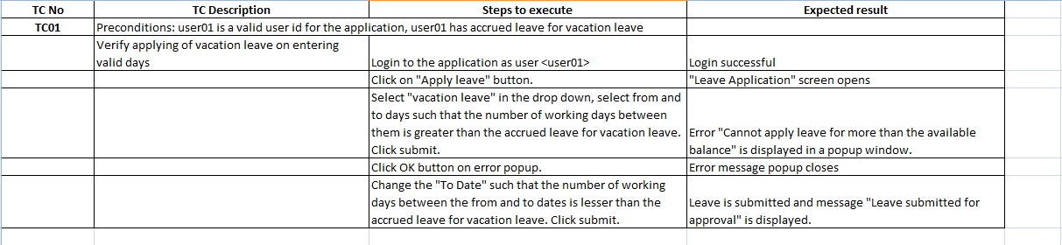
Test Case Development Process
Expand the test case to include the purpose of test, preconditions if any, method of testing with navigational steps, and expected results.
Example – TC01 is written as follows:

Slide 59
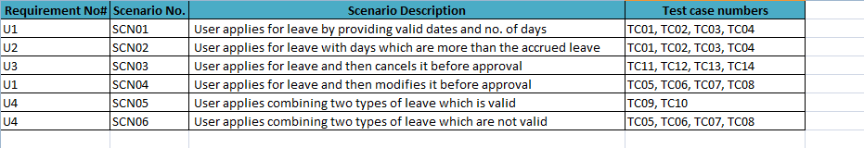
Test Case Development Process (Contd.)
Update the Traceability Matrix with the Test Case names to make sure the Test Coverage is guaranteed

Slide 60
Test Case Development Process (Contd.)
System Test Cases
Testing the behavior of a whole system/product as defined by the scope of a development project
Test environment should correspond to the final target or production environment to minimize the risk of environment-specific failures.
Tests both functional and non-functional requirements of the system.
System testing may include tests based on the following:
risks and/or on requirements specifications
business processes
use cases
other high level descriptions of system behavior
interactions with the operating system and system resources
Notes:
System testing:
System testing is concerned with the behavior of a whole system/product as defined by the scope
of a development project or programme.
In system testing, the test environment should correspond to the final target or production
environment as much as possible in order to minimize the risk of environment-specific failures not
being found in testing.
System testing may include tests based on risks and/or on requirements specifications, business
processes, use cases, or other high level descriptions of system behavior, interactions with the
operating system, and system resources.
System testing should investigate both functional and non-functional requirements of the system.
Requirements may exist as text and/or models. Testers also need to deal with incomplete or
undocumented requirements. System testing of functional requirements starts by using the most
appropriate specification-based (black-box) techniques for the aspect of the system to be tested.
For example, a decision table may be created for combinations of effects described in business
rules. Structure-based techniques (white-box) may then be used to assess the thoroughness of the
testing with respect to a structural element, such as menu structure or web page navigation.
An independent test team often carries out system testing.

Slide 61
Test Case Development Process (Contd.)
System Integration Test Cases
Integration testing tests interfaces between components and interactions with different parts of a system, such as the operating system, file system, hardware, or interfaces between systems.
Component integration testing tests the interactions between software components and is done after component testing.
System integration testing tests the interactions between different systems and may be done after system testing.
System integration testing strategies may be based on the system architecture (such as top-down and bottom-up), functional tasks, transaction processing sequences, or some other aspect of the system or component.
Notes:
Integration testing tests interfaces between components, interactions with different parts of a
system, such as the operating system, file system, hardware, or interfaces between systems.
1. Component integration testing tests the interactions between software components and is done
after component testing;
2. System integration testing tests the interactions between different systems and may be done
after system testing. In this case, the developing organization may control only one side of the
interface, so changes may be destabilizing. Business processes implemented as workflows
may involve a series of systems. Cross-platform issues may be significant.
The greater the scope of integration, the more difficult it becomes to isolate failures to a specific
component or system, which may lead to increased risk.
Systematic integration strategies may be based on the system architecture (such as top-down and
bottom-up), functional tasks, transaction processing sequences, or some other aspect of the system
or component. In order to reduce the risk of late defect discovery, integration should normally be
incremental rather than “big bang”.
Testing of specific non-functional characteristics (e.g. performance) may be included in integration
testing.
At each stage of integration, testers concentrate solely on the integration itself. For example, if they
are integrating module A with module B they are interested in testing the communication between
the modules, not the functionality of either module. Both functional and structural approaches may
be used.
Ideally, testers should understand the architecture and influence integration planning. If integration
tests are planned before components or systems are built, they can be built in the order required for
most efficient testing.

Slide 62
Test Case Development Process (Contd.)
Following are the Test Design Techniques
Equivalence Partitioning
Equivalence class is a subset of data that is representative of a larger class
It divides the input data of a software unit into partitions of data from which test cases can be derived
It attempts to cover classes of errors
In principle, test cases are designed to cover each partition at least once. So Test cases should be chosen from each partition

Slide 63
Test Case Development Process (Contd.)
Example
Consider the following requirement of LMS:
An employee is eligible to accrue one day of sick leave and two days of vacation leave per month. During the month of joining the employee is eligible for full month leave accrual if the employee has joined before 10th of the month. The employee is eligible for half the leave accrual if joined between 10th and 20th of the month and no leave accrual if joining date is beyond 20th of the month.
This would have the following three equivalence classes:
1. DoJ before 10th (no eligibility)
2. DoJ between 10th and 20th (eligible for half accrual)
3. DoJ after 20th (eligible for full accrual)
The Test Cases shall be chosen from the above equivalence classes
8th
16th
22nd
Before 10th
Between 10th and 20th
After 20th

Slide 64
Test Case Development Process (Contd.)
Boundary Value Analysis
A technique that consists of developing test cases and data that focuses on the input and output boundaries of a given function
Complements equivalence partitioning and selects the test cases at the “edge” of equivalence classes
Identify errors at boundaries rather than finding those that exist in center of input domain
Tests are designed to include representatives of boundary values

Slide 65
Test Case Development Process (Contd.)
Example
Consider the following requirement of LMS:
For availing compensatory off, the employee should have worked for a minimum of 6 hours on a holiday.
In this requirement, the boundary analysis would test the following:
1. Lower boundary (5 hours)
2. On the boundary (6 hours)
3. Upper boundary (7 hours)
Following are the range of Boundary Values:
Value immediately below range
First value of range
Second value of range
Value immediately below last value of range
Last value of range
Value immediately above range

Slide 66
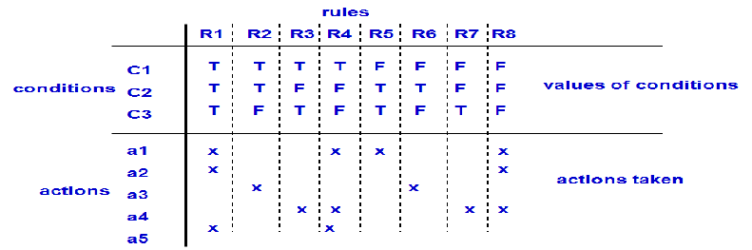
Test Case Development Process (Contd.)
Decision Table
A Decision table lists causes and effects in a matrix. Each column represents a unique combination.
Its purpose is to structure logic.
It is a precise yet compact way to model complicated logic.
Cause = condition
Effect = action = expected results
Notes:
- The decision table allows the iteration of all the combinations of values of the condition, thus it provides a “completeness check.”
- The conditions in the decision table may be interpreted as the inputs, and the actions may be thought of as outputs. OR conditions needs to be thought as inputs needed set the conditions, and actions can be processing

Slide 67
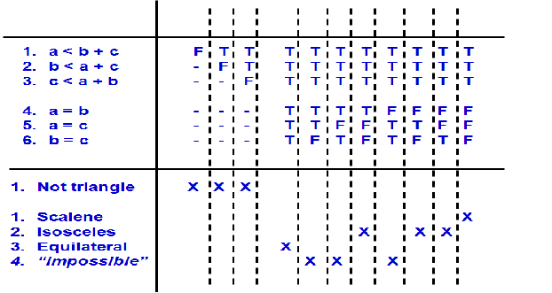
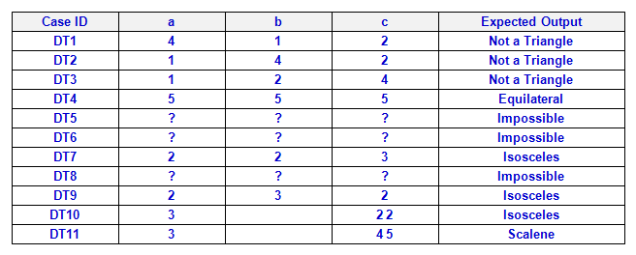
Test Case Development Process (Contd.)
Decision Table - Example
Consider a program statement that, given the length of 3 sides, determines whether the 3 sides can
(1) form a triangle and
(2) what type of triangle (equilateral, isosceles, or scalene).
The inputs are a, b, c sides
Then the inputs must satisfy certain conditions:
a < b + c
b < a + c
c < a + b
Notes:
In this example we take three inputs, and from those inputs we perform conditional checks to calculate if it’s a triangle, if so then what type of triangle it is. The first 3 conditions we add must check whether all 3 sides constitute a triangle, as we don’t want to perform other checks if the answer is false.
Then the remainder of the conditions will check whether the sides of the triangles are equal or not. As there are only three sides to a triangle means that we have three conditions when checking all of the sides.
So the conditions for the table would be:
1. a<b+c
2. b<a+c
3. C<a+c
[the above 3 conditions checks whether a, b, c form a triangle?]
4. a = b?
5. a = c?
6. b = c?
The first 3 test conditions in the Decision table checks for the “invalid situation” - not a triangle
There are 3 types of valid; so there are 2³ = 8 potential conditions
But there are 3 “impossible” situations in this 8 potential conditions
Also remember that:
Number of Rules = 2^{Number of Conditions}

Slide 68
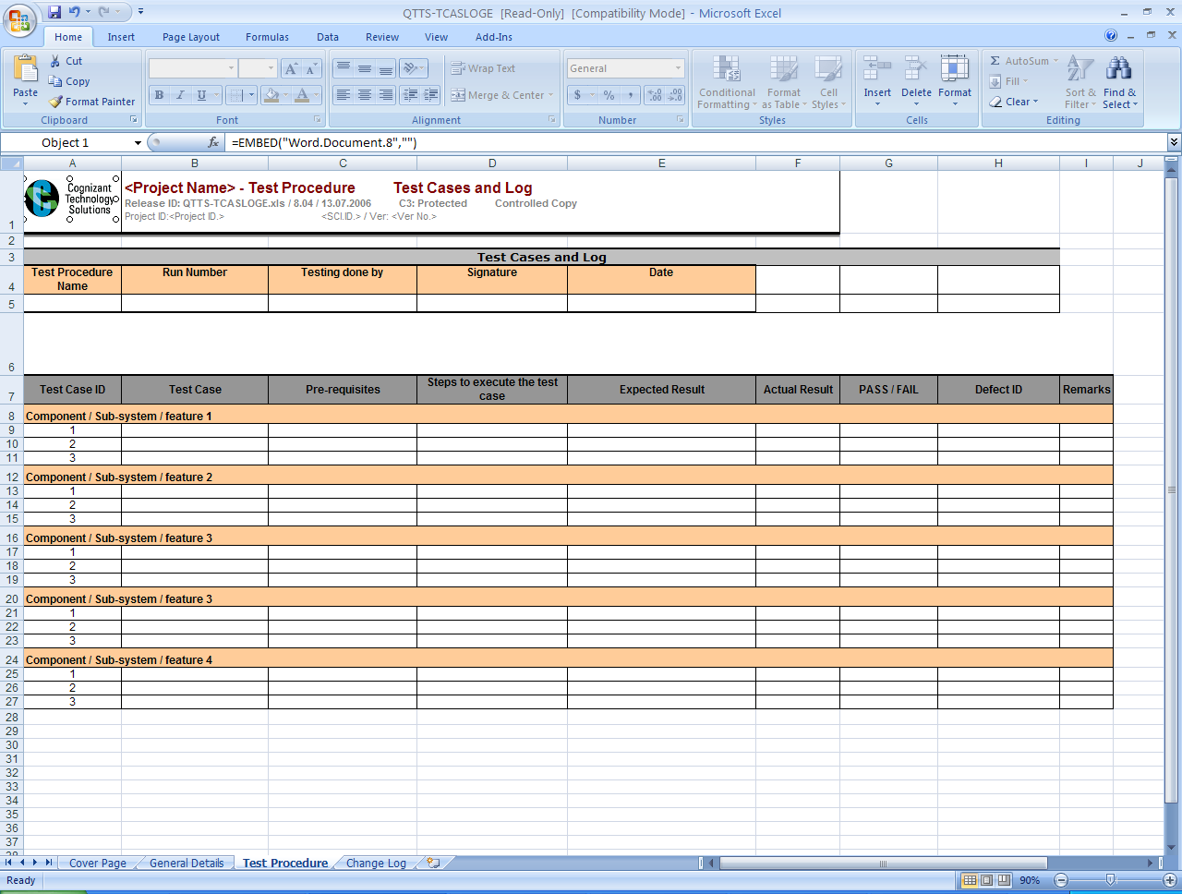
Test Case Template- Sample
Fig: Test Case Template

Slide 69
Test Case Components
Following are the components of Test Case:
Test Case ID: It is a unique ID to identify a test case. This can be as per the agreed naming standards from the client.
Test Case: This section describes the test case objective/ description of the what the test case is intended to test.
Pre-Requisites: This section details the actions that are required beforehand that is, a necessary action that is to be completed before start of the Test case.
Steps to Execute the Test case: This section describes the steps to execute the test. It includes the user actions to be performed, navigation flows to other screens, appropriate inputs, verification point, and so on.
Test Data: Test Data is an optional column. It can be given as a part of steps to execute or at times given as a separate column in a test case.
Expected Results: The outcome that is expected to happen when the “Steps to Execute” are performed is detailed in this section.
Notes:
Components of a Test case:
Components are listed below with each section explained in brief:
Test Case ID: A unique ID to identify a test case. This can be as per the agreed naming standards as per the client
Test Case: This section describes the test case objective/ description of the what the test case is intended to test
Pre-Requisites: This section details the actions that are required beforehand i.e. a necessary action that is to be completed before start of the Test case
Steps to Execute the Test case: Describes the steps to execute the test and this includes the User actions to be performed, navigation flows to other screens, providing appropriate inputs, verification point, etc.,
Test Data: Test Data is an Optional column. It can be given as a part of steps to execute or at times given as a separate column in a test case
Expected Results: The outcome that is expected to happen when the “Steps to Execute” are performed is detailed in this section.
Actual Results : The outcome that happened as a result of executing the test steps will be entered in this section during the test execution phase
PASS/FAIL : The status of the test step is decided based on the expected result and actual result. When both results are the same the step is ‘PASS’ and when there is a deviation of Actual from Expected then the step is Failed
Defect ID : This section includes the Defect ID (unique number) that is raised against the failed test step for this test case. Same test case can be mapped to more defects and same defect ID can be mapped to more test cases
Remarks : Remarks or comments about the test case or test execution or any general remarks will be listed against the test case if any
The Template can be customized according to client to include /remove test case components. For example, Requirement, Test Scenario, Screen Name, Test data, Module Names can also be included as a part of the test case document

Slide 70
Test Case Components
Actual Results: The outcome that happened as a result of executing the test steps will be entered in this section during the test execution phase.
PASS/FAIL : The status of the test step is decided based on the expected result and actual result. When both results are the same the step is ‘PASS’ and when there is a deviation of the actual from the expected then the step is Failed.
Defect ID : This section includes the Defect ID (unique number) that is raised against the failed test step for this test case. Same test case can be mapped to more defects and same defect ID can be mapped to more test cases.
Remarks : Remarks or comments about the test case or test execution or any general remarks will be listed against the test case if any.
* A section for Test Requirement/Test Scenario can be added, if required by the client.
** The template can be customized across projects
*** The Columns ‘Actual Results, PASS/FAIL, Defect ID’ will be filled against each test case after the test execution phase for that particular test case
Notes:
Components of a Test case:
Components are listed below with each section explained in brief:
Test Case ID: A unique ID to identify a test case. This can be as per the agreed naming standards as per the client
Test Case: This section describes the test case objective/ description of the what the test case is intended to test
Pre-Requisites: This section details the actions that are required beforehand i.e. a necessary action that is to be completed before start of the Test case
Steps to Execute the Test case: Describes the steps to execute the test and this includes the User actions to be performed, navigation flows to other screens, providing appropriate inputs, verification point, etc.,
Test Data: Test Data is an Optional column. It can be given as a part of steps to execute or at times given as a separate column in a test case
Expected Results: The outcome that is expected to happen when the “Steps to Execute” are performed is detailed in this section.
Actual Results : The outcome that happened as a result of executing the test steps will be entered in this section during the test execution phase
PASS/FAIL : The status of the test step is decided based on the expected result and actual result. When both results are the same the step is ‘PASS’ and when there is a deviation of Actual from Expected then the step is Failed
Defect ID : This section includes the Defect ID (unique number) that is raised against the failed test step for this test case. Same test case can be mapped to more defects and same defect ID can be mapped to more test cases
Remarks : Remarks or comments about the test case or test execution or any general remarks will be listed against the test case if any
The Template can be customized according to client to include /remove test case components. For example, Requirement, Test Scenario, Screen Name, Test data, Module Names can also be included as a part of the test case document

Slide 71
Test Case - Sample1
Following is a sample Test Case
Test Case ID: Admin_Add User
Test Case: To verify that an administrator is able to add a new user to the system after providing the required information.
Precondition: The user should have logged on as an administrator and should be on the main page.
Notes:
The Test Case here is a type of Simple Test Case
This is to Test the ‘Creation Of a User’ or ‘Add a new user’

Slide 72
Test Case - Sample1 (Contd.)
Test Case
S No | Step | Expected Result | Actual Result | Pass/Fail
1 | Select “User->Add” from the application menu | “Add User” page should be displayed
2 | Click [Add] | An error message indicating that the “User ” is required should be displayed
3 | Click [OK] | Error message should be closed
4
5 | Enter ‘user0001’ in the “User ” field Click [Add] | An error message indicating that the “First Name” is required should be displayed
6 | Click [OK] | Error message should be closed
7 | Enter ‘Tom’ in the “First Name” field Click [Add] | An error message indicating that the “Last Name” is required should be displayed
Notes:
The Test Case here is a type of Simple Test Case
This is to Test the ‘Creation Of a User’ or ‘Add a new user’

Slide 73
Test Case - Sample1 (Contd.)
S No | Step | Expected Result | Actual results | Pass/Fail
8 | Click [OK] | Error message should be closed
9 | Enter ‘Moody’ in the “Last Name” field Click [Add] | “Confirmation” page should be displayed indicating that the user was added successfully
10 | Close the “Confirmation” page | “Confirmation” page is closed
11 | Open the application and log on as ‘admin0001’ | Main page should be displayed
12 | Select “User-> Search” from the application menu | “Search User” page should be displayed
13 | Enter ‘user0001’ in the “User ” field Click [Search] | The user with ‘user0001’ should be retrieved
14 | Click on the User – ‘user0001’ | “Update User” page for the user ‘user0001’ should be displayed
15 | Check the value in the “User ” field | “User ” should be displayed as ‘user0001’
16 | Check the value in the “First Name” field | “First Name” should be displayed as ‘Tom’
17 | Check the value in the “Last Name” field | “Last Name” should be displayed as ‘Moody’

Slide 74
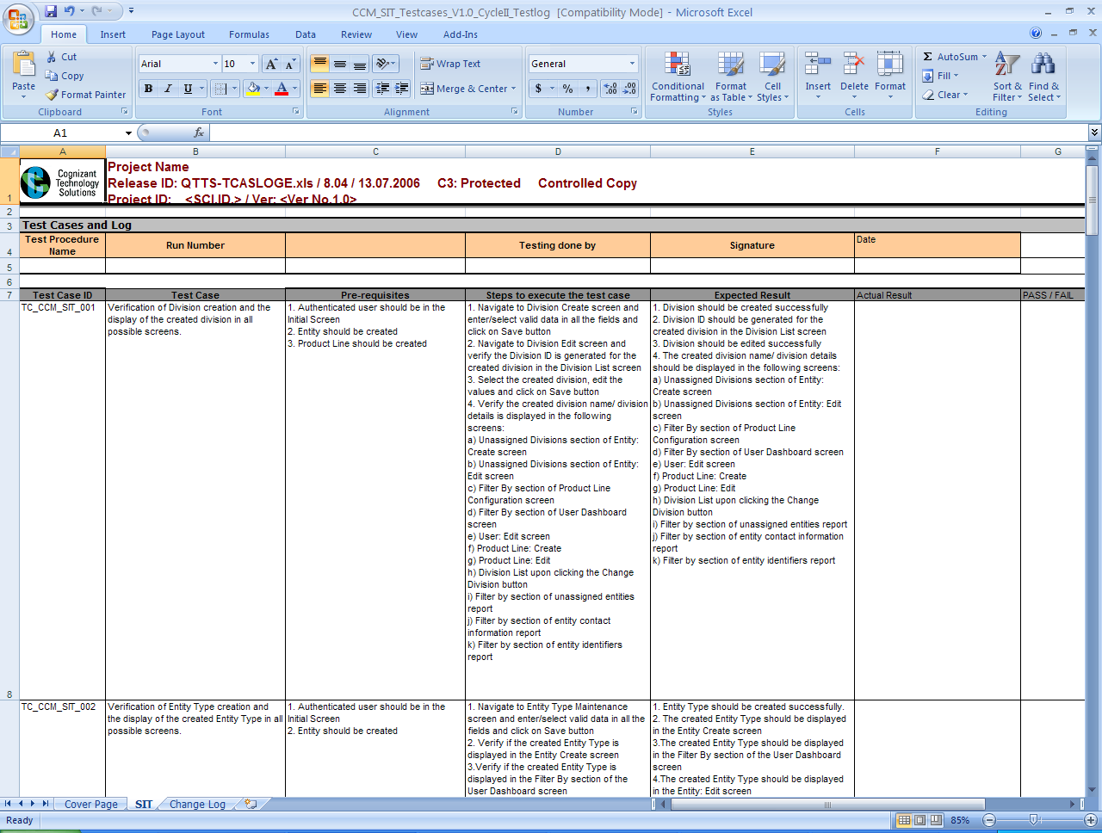
Test Case - Sample 2
Fig: Test Case
Notes:
Example 2-Sample Test case in a different template

Slide 75
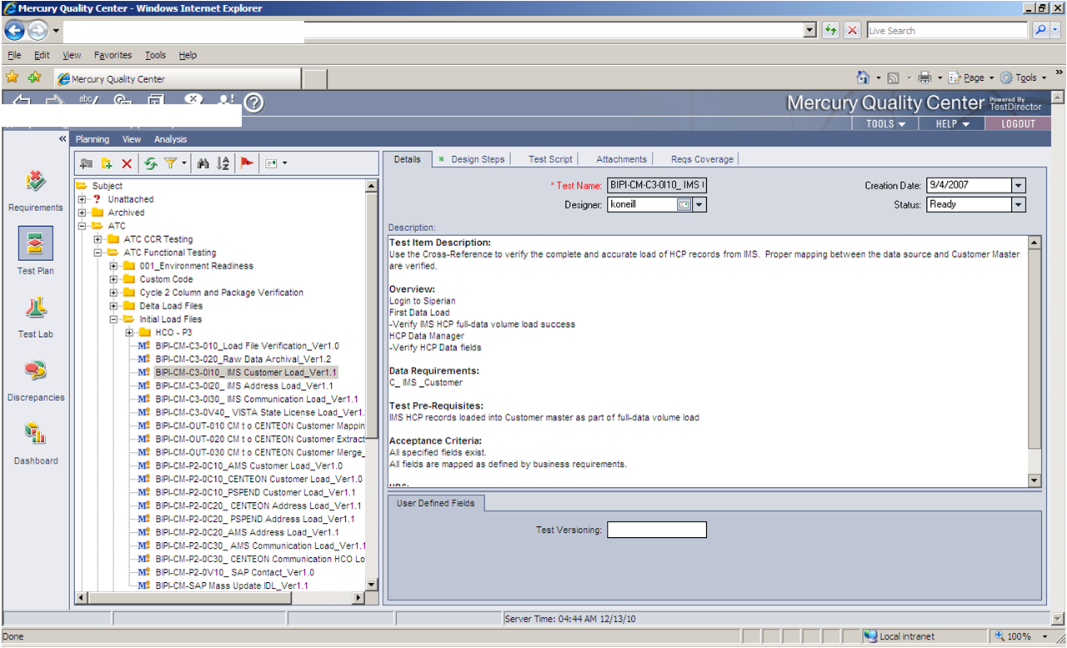
Test Case Example: (Details Tab in QC)
Fig: System Test Case—Details Tab in QC

Slide 76
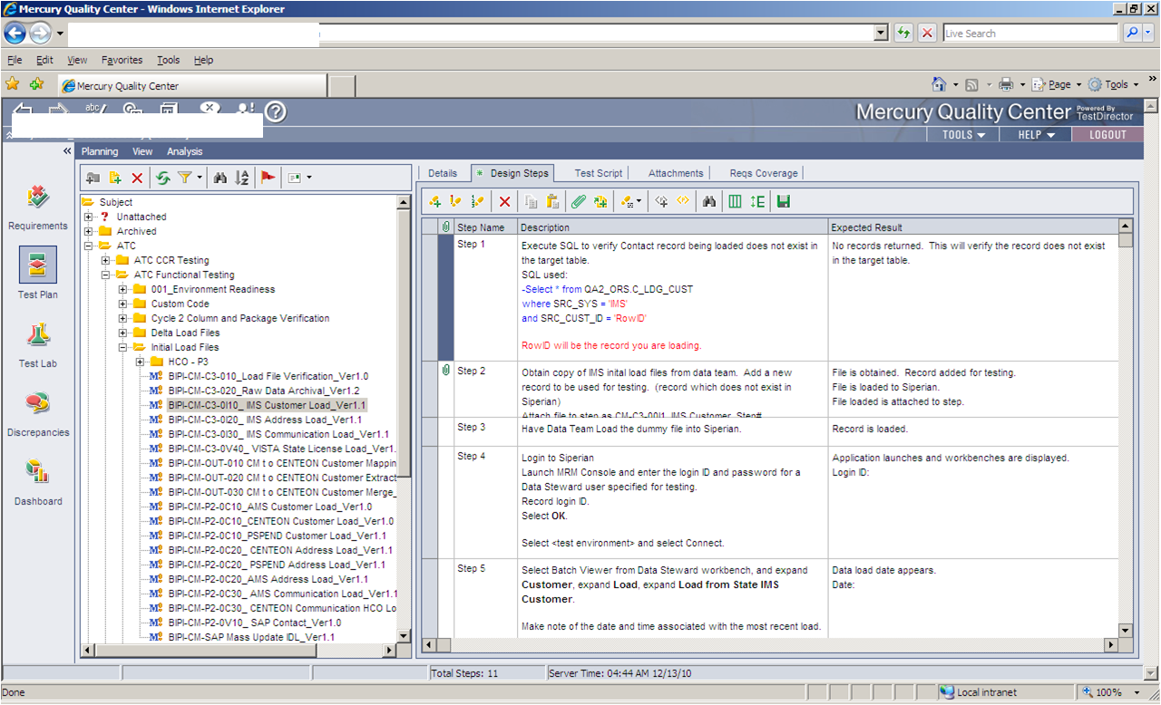
Test Case Example: (Design Steps Tab in QC)
Fig: System Test Case-Design Steps Tab in QC

Slide 77
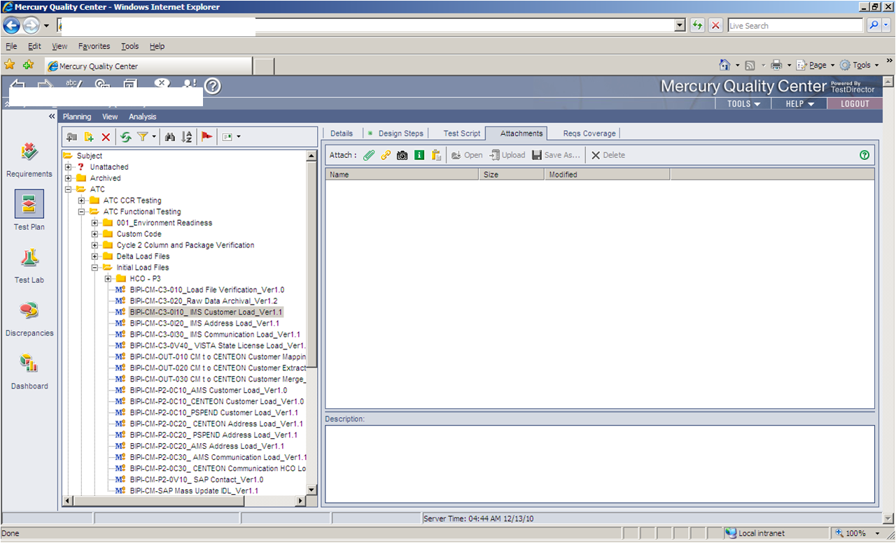
Test Case Example: (Attachments Tab in QC)
Fig: System Test Case-Attachments Tab in QC

Slide 78
Review Types – Test Case Review
Review of Test Case Artifact: After a Test Case is designed, it undergoes two cycles of review with the help of checklist for each. Following are the two types of review:
Self Review
Peer Review
Following are the features of Self Review:
Reviewed by the Author himself
Reviewed based on the Self Review checklist
Comments observed are fixed by the author himself
Reporting of results is not required
Notes:
Review Types:
Self Review: Reviewed by the Author himself based on the Review checklist and the review defects are fixed
Peer Review: Led by a Peer group or Subject matter experts. This can be done in two ways
Formal Review
Formal review is structured approach which will be conducted by subject matter experts in absence of the author. Artifact is examined for defects by individuals other than the person who produced it. Reviews help to uncover defects and to ensure product compliance to specifications, standards or regulations. There may be more than one reviewer in the formal review. Active and open participation of everyone in the review group, following traditions, customs, and written rules for review will be followed in this case. This review can be done either electronically or physically / manually. The review comments needs to be fixed by the author.
In formal review, all participants will be fully responsible for the quality of the review and for the quality of the information in the written report. Formal reviews can be conducted during any point in the lifecycle.
Informal Review
One or more reviewers may conduct the informal review, but the review results will not be reported in any format. Informal review is done to make the product ready for formal reviews. Typically used for screen designs, small routines that may not require a formal inspection or a walkthrough. The review comments needs to be fixed by the author.

Slide 79
Review Types – Test Case Review (Contd.)
Peer Review: A peer review is led by a Peer group or Subject Matter Experts. This can be done in the following two ways:
Formal Review
Conducted by Subject Matter Experts in the absence of the author
Conducted by one/more reviewers
Author sends the artifact to be reviewed along with related items to the reviewer
Reviewers review the work product and prepare the review report
The review comments are fixed by the author and the review report is updated
Formal reviews can be conducted during any point in the lifecycle
Informal Review
Conducted by one or more peers in the group
Review results will not be reported in any format
Informal review is done to make the product ready for formal reviews
The review comments needs to be fixed by the author
Notes:
Review Types:
Self Review: Reviewed by the Author himself based on the Review checklist and the review defects are fixed
Peer Review: Led by a Peer group or Subject matter experts. This can be done in two ways
Formal Review
Formal review is structured approach which will be conducted by subject matter experts in absence of the author. Artifact is examined for defects by individuals other than the person who produced it. Reviews help to uncover defects and to ensure product compliance to specifications, standards or regulations. There may be more than one reviewer in the formal review. Active and open participation of everyone in the review group, following traditions, customs, and written rules for review will be followed in this case. This review can be done either electronically or physically / manually. The review comments needs to be fixed by the author.
In formal review, all participants will be fully responsible for the quality of the review and for the quality of the information in the written report. Formal reviews can be conducted during any point in the lifecycle.
Informal Review
One or more reviewers may conduct the informal review, but the review results will not be reported in any format. Informal review is done to make the product ready for formal reviews. Typically used for screen designs, small routines that may not require a formal inspection or a walkthrough. The review comments needs to be fixed by the author.

Slide 80
Review Process - Workflow
Adhere to the following workflow while conducting formal reviews:
Define the scope and objective of review
Plan the logistics for review
Prepare specific checklist for review (if required), or use the generic checklist
Ensure expert members are part of the identified reviewers
Circulate the artifact or product (in this scenario, Test Case document is the artifact)
Perform Test Case Review
Consolidate the review comments
Prepare review report
Author needs to evaluate the review comments / defects identified and assign defects for the authoring team (henceforth referred as team) to fix (as required)
Notes:
Review - Tasks
Below workflow needs to be followed for conducting formal reviews:
Define the scope and objective of review
Plan the logistics for review
Preparation of specific checklist for review (if required), or use the generic checklist available in QMS
Ensure expert members are part of the identified reviewers
Circulate the artifact or product
Consolidate the review comments
Prepare review report (either QMS format or any standard tool)
Author needs to evaluate the review comments / defects identified and assign defects for the authoring team (henceforth referred as team) to fix (as required)
Update the tool / review report for the action(s) taken
Submit the artifact or product for a re-review after the team reworks based on the review comments (as required)
Reviewer(s) check whether the follow up action has been taken by the team against all the review comments raised; and whether suitable remarks are given if the review comment or defect has not been fixed. On completing this, the reviewer(s) closes the review comment / defect in the report or tool.
The artifact or product can be sent for approval on closure of all comments, and getting the go-ahead from the review team.

Slide 81
Review Process – Workflow (Contd.)
Update the tool / review report for the actions taken
Submit the artifact or product for a re-review after the team reworks based on the review comments (as required)
Reviewers check whether the follow-up action has been taken by the team against all the review comments raised. Also, check whether suitable remarks are given if the review comment or defect has not been fixed. On completing this, the reviewers close the review comment / defect in the report
The artifact or product can be sent for approval on closure of all comments and getting the go-ahead from the review team
Notes:
Review - Tasks
Below workflow needs to be followed for conducting formal reviews:
Define the scope and objective of review
Plan the logistics for review
Preparation of specific checklist for review (if required), or use the generic checklist available in QMS
Ensure expert members are part of the identified reviewers
Circulate the artifact or product
Consolidate the review comments
Prepare review report (either QMS format or any standard tool)
Author needs to evaluate the review comments / defects identified and assign defects for the authoring team (henceforth referred as team) to fix (as required)
Update the tool / review report for the action(s) taken
Submit the artifact or product for a re-review after the team reworks based on the review comments (as required)
Reviewer(s) check whether the follow up action has been taken by the team against all the review comments raised; and whether suitable remarks are given if the review comment or defect has not been fixed. On completing this, the reviewer(s) closes the review comment / defect in the report or tool.
The artifact or product can be sent for approval on closure of all comments, and getting the go-ahead from the review team.

Slide 82
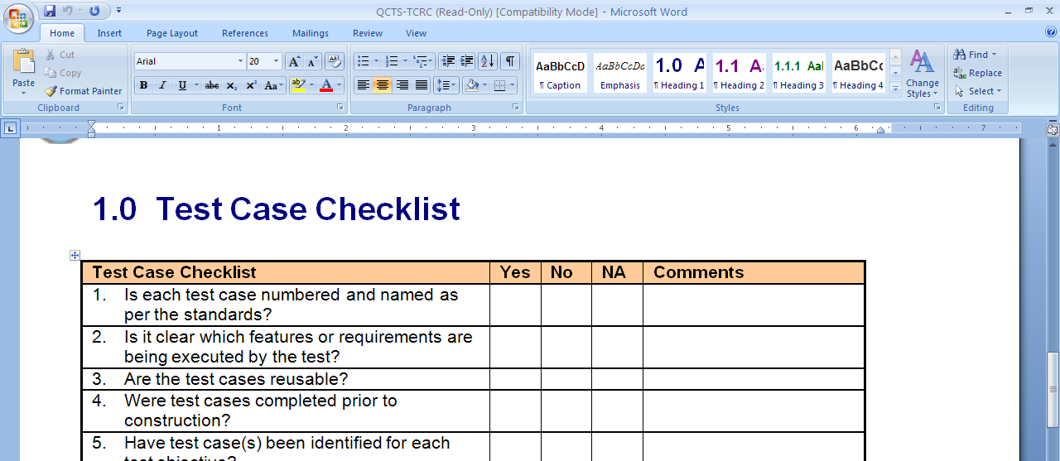
Test Case Review Checklist
Test Case Review checklist is used by reviewers to ensure that the Test Case is designed based on agreed standards
Test Case Review checklist can be customized according to project requirements
Following are the benefits of Review Checklist:
Avoids rework
Helps to detect defects at an earlier stage
Can be customized based on project specific standards
Fig: Sample review checklist for Test case review
Notes:
Review Checklist for Test Case Review:
Review checklist is used by reviewers to ensure that the Test Case is designed based on agreed standards. The template can either be from Cognizant or Client specific or Client approved template. Review checklist should cover Items that uncover defects in the below areas:
Requirement coverage
Test Case Template Used
Font and Size
Test Case Meets the Test Objective
Project specific standards if any
Test Case Components
Correct Test Data
Test Conditions are provided
Negative scenarios are covered, if any
Against each checklist item, the reviewer fills in either Yes/No/NA
Yes→ if the test case meets the mentioned item
No→ if the test case does not meet the specific mentioned item in the checklist
NA→ if the item mentioned is not applicable for the reviewed test case then NA against the particular item
Comments → this section provides additional information to the author about the review comment
Reviewer, reviews the Test case with the help of Review checklist and based on his observation provides ‘Review Comments’. The Review Comments are to be analyzed by the ‘Author’ and the Valid comments are addressed and changes are incorporated in the Test Case

Slide 83
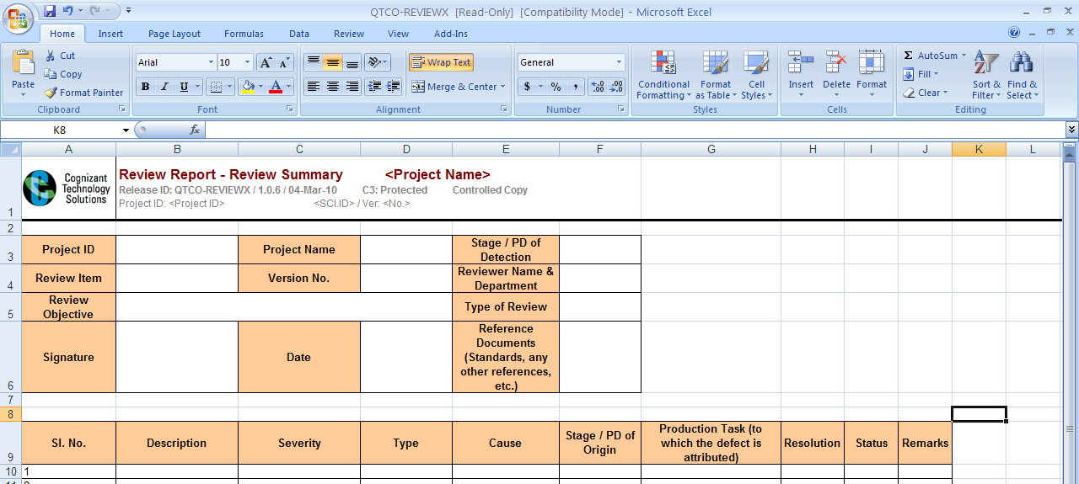
Test Case Review Report
Test Case Review Report is a document to consolidate the review comments
For each review comment, the Severity, Cause, and Type are identified and it is assigned to the author
The author analyzes the comments, updates the Test case, and accordingly, fixes the comment, and closes the review defect
Fig: Sample Review Report
Notes:
Review Report: Review Report is a document to consolidate the review comments project wise /module wise
Review Report contains the below sections to be filled:
Description: Description the review comment
Severity: severity of the review comment – either Major (in case it’s a requirement coverage defect), Minor and Superficial (in case of Typo error, etc)
Type: This section describes the Type of the review comment.(Either Incorrect Functionality/ Documentation or Typo error, etc)
Cause: Cause of the review defect is provided here. (like Omission, lack of knowledge, miscommunication, accidental etc)
Stage of origin: The defect origin stage is provided here
Resolution: Resolution provided by the author after addressing the comment by reviewer, is been provided here
Status: The defect will be in ‘Open’ when newly found and raised as a review defect. The Review defect is ‘Assigned’ to the author. It is then addressed by the author and changed to ‘Resolved’ status. Reviewer checks if the follow up resolution is proper and if so, ‘Closes’ the defect.

Slide 84
Test Case Review Report (Contd.)
Following are the benefits of Review Report:
Consolidate the review report with the list of all review comments
Identify the frequently occurring review defects which are repetitive
Update the review checklist with the frequently occurring repetitive review defects
Avoid repetition of review defects by following updated review checklist derived from the review report
Notes:
Benefits of Review Report
Consolidates the Review comments
Root cause Analysis can be done for the defects based on the Type of Review defect reported
Defect prevention action can be taken based on the results from Root Cause Analysis
Repetition of defects can be minimized
Root Causal Analysis Techniques
The below techniques are used to perform Root causal analysis for the defect types. For e.g. if there are more number of defects under the type “Documentation /typo error” and then
Pareto analysis
5-Why analysis
Fish-Bone diagram

Slide 85
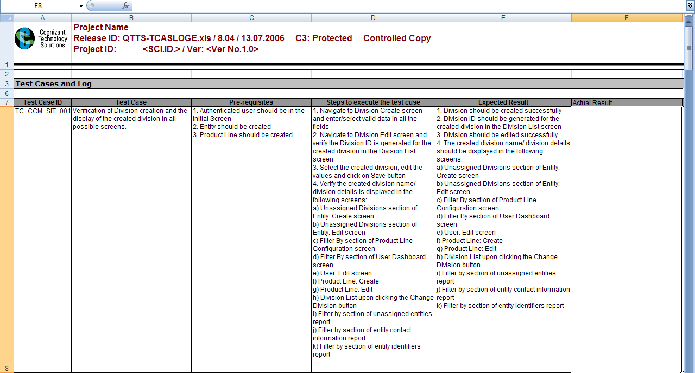
Test Case Review Process (Case Study)
Sample Test Case: In the following test case, details are entered in the first step of the test case, but the procedure for ‘Saving’ the entered details is missing
Fig: Test Case Review
Notes:
Example for Test case Review:
The Test case tests the below scenario.
A record created in one screen should be reflected in all the other related screens.
“Division” is created in “Division create” screen and edited in “Division Edit” screen. The created Division is checked in other screens where the Division Lists will be available.
But here in the first step, the details are entered in the “Division create” screen fields. The step for Saving the entered details is missing.
This is been reported as a review comment
The First step should be 1. Navigate to Division Create screen and enter/select valid data in all the fields and click on ‘Save’ button

Slide 86
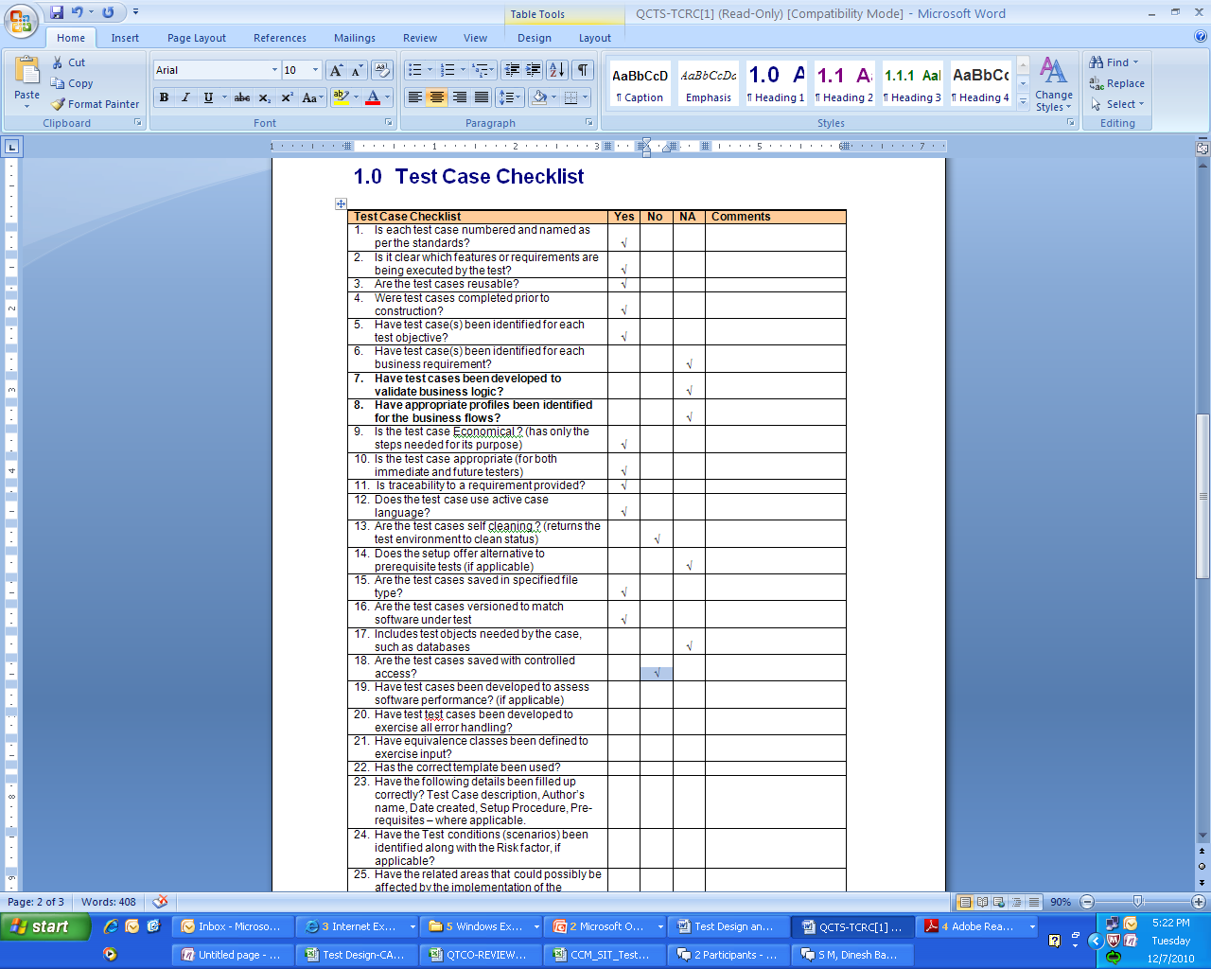
Test Case Review Process (Case Study) (Contd.)
Fig: Test Case Review Checklist
Test case is been reviewed based on the Review checklist and the applicable option is selected against each review item
Also, the test case is verified for the following items and comments logged:
Flow of steps in test case
Traceability of test case to requirements
Coverage
Clear steps for Navigation to screens in the application
Test steps are relevant to the test objective
Notes:
Test case is been reviewed based on the Review checklist and the applicable option is selected against each review item.
Each review item is been taken for the given test case and review comments are provided by the reviewer
Also the test case is verified for the below items and comments are logged:
Flow of steps in test case
Traceability of test case to requirements
Coverage
Clear steps for Navigation to screens in the application
Test steps are relevant to the test objective

Slide 87
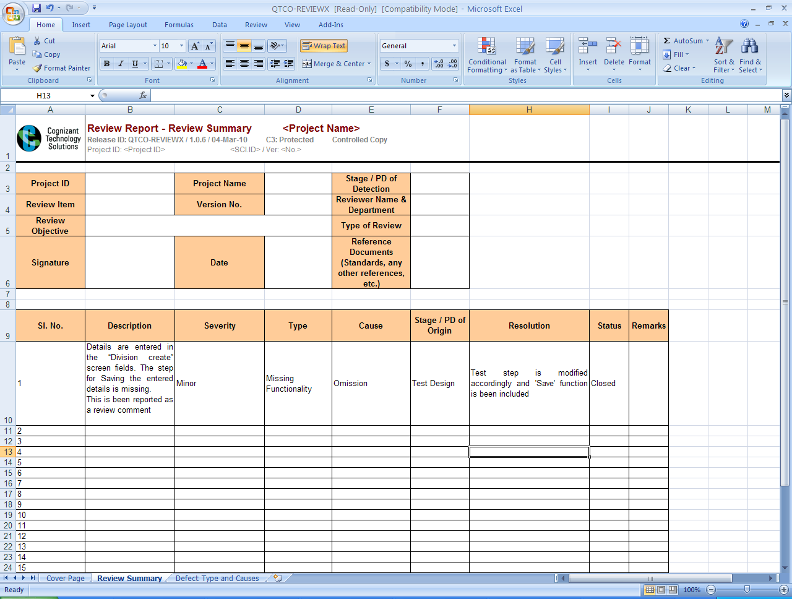
Test Case Review Process (Case Study) (Contd.)
Fig: Test Case Review Report
Review comment is tracked in the Review report.
Notes:
Review Report is updated with the review comments by the reviewer. Initially the status of the defect will be ‘Open’ and then it is ‘Assigned’ to the author. The author works on it with the status ‘Fix in Progress’ and once done, changes the status to ‘Resolved’ and updates the resolution column. If the author had addressed the review comment properly, then the Status is changed to ‘Closed’.
All the review comments are tracked in this report and based on the number of defects for each defect type, the root causal analysis is done.
The arrived results help to identify the root cause of the review defects and helps to minimize the defects.

Slide 88
Test Coverage
Following are the purposes of Test Coverage:
Based upon the risk and criticality associated with the application under test, the project team should establish a coverage goal during the test planning phase itself.
The coverage goal defines the include the functionality and the depth of testing that must be executed by the tests for the application.
The objective of test coverage is to assure that the test process has covered the application. In Black Box Testing the coverage goal is represented in terms of requirements like % of Requirements covered during the Testing.
Coverage refers to the extent to which a given verification activity has satisfied its objectives.
Attaining 100% coverage can lead away from the real goal of testing:
Finding as many defects as possible in as short a time as possible.
Finding the highest risk defects.
Notes:
Each project must choose a minimum percent coverage for release criteria based on available testing resources and the importance of preventing post-release failures.
You might have to set a higher coverage goal for unit testing than for system testing since a failure in lower-level code may affect multiple high-level callers.
Some people feel that setting any goal less than 100% coverage does not assure quality. However, you expend a lot of effort attaining coverage approaching 100%. The same effort might find more bugs in a different testing activity.
Coverage analysis exposes some reasonable bugs but does not come close to exposing all classes of bugs.
Coverage analysis provides more benefit when applied to an application that makes a lot of decisions rather than data-centric applications, such as a database application.

Slide 89
Test Coverage (Contd.)
Coverage is a measure and not a method or a test.
Coverage measures can be applied to any verification activity, although they are most frequently applied to testing activities.
Appropriate coverage measures give a sense of adequacy of the verification accomplished to the people managing and auditing verification activities. In essence, it provides an exit criteria for when to stop.
Requirement Traceability Matrix is a very good tool to identify the Test Coverage from the Requirements.
Notes:
Each project must choose a minimum percent coverage for release criteria based on available testing resources and the importance of preventing post-release failures.
You might have to set a higher coverage goal for unit testing than for system testing since a failure in lower-level code may affect multiple high-level callers.
Some people feel that setting any goal less than 100% coverage does not assure quality. However, you expend a lot of effort attaining coverage approaching 100%. The same effort might find more bugs in a different testing activity.
Coverage analysis exposes some reasonable bugs but does not come close to exposing all classes of bugs.
Coverage analysis provides more benefit when applied to an application that makes a lot of decisions rather than data-centric applications, such as a database application.

Slide 90
Regression Test Design
For each of the levels of testing, regression tests should also be designed.
Regression testing is carried out for the following reasons:
To uncover software errors after changes to the program.
To assure that a change, such as a bug fix, did not introduce new bugs.
To test the system efficiently by systematically selecting the appropriate minimum suite of tests.
Notes:
Regression testing:
Testing that seeks to uncover software errors after changes to the program.
To assure that a change, such as a bug fix, did not introduce new bugs.
To test the system efficiently by systematically selecting the appropriate minimum suite of tests needed to adequately cover the affected change.

Slide 91
Common Methods of Regression Testing
Regression testing include re-running previously run tests to checking whether:
Program behavior has changed.
Previously fixed defects have re-emerged.
New defects are introduced.
This is done by comparing results of previous tests to results of the current tests being run.
Notes:
Regression testing include rerunning previously run tests to checking whether:
Program behavior has changed.
Previously fixed defects have re-emerged.
New defects are introduced.
This is done by comparing results of previous tests to results of the current tests being run.

Slide 92
Regression Test Suites
Set of test scenarios and test cases are designed to ensure that software is accurate and correct after undergoing corrections or changes.
Each level of testing (i.e., unit testing, system testing, system integration testing and acceptance testing) should have its own regression test suite.
Notes:
Regression test suite:
Set of test scenarios and test cases that are designed to ensure that software is accurate and correct after undergoing corrections or changes.
Each level of testing (i.e., unit testing, system testing, and acceptance testing) should have its own regression test suite.
For example, unit testing would have a set of white box tests used to originally test the code or designed to test the changed area, system testing would have a set of black box tests, and acceptance testing would have a separate set of black box tests.

Slide 93
Types of Test Suites
Regression test suites can be automated or manual.
When determining whether to automate, consider how often the test will be used. Creation of an automated test is approximately 10 times more costly than the creation of a manual test.
However, a manual test will cost approximately the same amount each subsequent time it is run because the same sequence of entries must be made.
For tests designed to thoroughly exercise an isolated area due to a change in the software, a manual approach is more economical because these tests are not likely to be reused.
Notes:
Types of Test Suites:
Regression test suites can be automated or manual.
When determining whether to automate, consider how often the test will be used. Creation of an automated test is approximately 10 times more costly than the creation of a manual test.
However, a manual test will cost approximately the same amount each subsequent time it is run, because the same sequence of entries must be made.
An automated test, which is recorded or programmed, plays back the recorded or programmed keystrokes when it is run. The automated test will cost very little each subsequent time it is run, particularly if it is run unattended.
For example, for system testing, it is a good idea to create a few basic test cases that exercise most frequently used functions, using a typical task order. These tests are good candidates for automation and can be rerun on a periodic basis to ensure no new defects have been introduced. However, some time is required to incorporate modifications to the software into the automated test script.
For tests designed to thoroughly exercise an isolated area due to a change in the software, a manual approach is more economical, because these tests are not likely to be reused.

Slide 94
Creating the Regression Test Suites
Based on the impact caused to the system, test suites are created and prioritized.
Prepare a written script early in the development process using the applicable testing technique. This script is used to either guide the manual testing process, or to record or program the test sequence using an automated tool.
Retain test suites prepared during development for regression testing during development, and for later use during maintenance.
To retain regression tests conducted as part of the normal maintenance process.
Notes:
Creating the Regression Test Suites:
Based on the impact caused to the system, test suites are created and prioritized.
Prepare a written script early in the development process using the applicable testing technique.
This script is used to either guide the manual testing process, or to record or program the test sequence using an automated tool.
Retain test suites prepared during development for regression testing during development, and for later use during maintenance.
Use the same data when using the original test script for regression testing.
Organize or supplement the test suites as necessary to create a few typical scenarios for basic regression testing.
For legacy systems that do not have a regression test suite, create a test suite for maintenance purposes.
One easy way to build a test suite is to retain regression tests conducted as part of the normal maintenance process.
Keep the test suite either in a word processor or file folder if a manual approach is used, or in a library of automated scripts, if automated.

Slide 95
Selecting Regression Suite
The issue is how to select effective regression test suite so that the number of tests do not grow too large and minimize the running cost of regression. There are many methods to select regression test suite.
One of the effective method is to categorize all functional tests based on functionality. From each category select the minimum number of tests to be rolled into regression suite. Selection should be based on the following:
All tests which cover multiple functionalities
All tests which cover critical functionalities
All Boundary value test cases
Some of the positive test cases
Some of the negative test cases
Notes:
Selecting regression suite:
The issue is how to select effective regression test suite so that the number of tests does not grow too large and minimize the running cost of regression. There are many methods to select regression test suite.
One of the effective method is:
Categorize all functional tests base on functionality. From each category select the minimum number of tests to be rolled into regression suite. Selection should be base on:
All tests which covers multiple functionalities
All tests which covers critical functionalities
All Boundary value test cases
Some of positive test cases
Some of negative test cases
Maintaining the Test Suite:
Be careful not to modify the test script in a manner that conflicts or causes an error in another test script.
Ensure that testing of another requirement is not removed as a result of the change.
Evaluate test scripts regularly to ensure their reliability.

Slide 96
Selecting Regression Suite (Contd.)
Ensure the following while maintaining the Test Suite:
Not to modify the test script in a manner that conflicts or causes an error in another test script
Testing of another requirement is not removed as a result of the change
Test scripts are evaluated regularly to ensure their reliability
Notes:
Selecting regression suite:
The issue is how to select effective regression test suite so that the number of tests does not grow too large and minimize the running cost of regression. There are many methods to select regression test suite.
One of the effective method is:
Categorize all functional tests base on functionality. From each category select the minimum number of tests to be rolled into regression suite. Selection should be base on:
All tests which covers multiple functionalities
All tests which covers critical functionalities
All Boundary value test cases
Some of positive test cases
Some of negative test cases
Maintaining the Test Suite:
Be careful not to modify the test script in a manner that conflicts or causes an error in another test script.
Ensure that testing of another requirement is not removed as a result of the change.
Evaluate test scripts regularly to ensure their reliability.

Slide 97
Impact Analysis
Suppose after completion of an application or module, if another module is to be added, then we need to test the new module as well as the impacted area which is affected by adding a new module
The process of understanding the complete effect of a particular change in order to determine how this change will impact the testing process is known as impact analysis
Impact analysis is typically carried out in order to identify the test cases for regression
Impact analysis is required during the following instances:
Testing after Bug fixing
Change to the requirements
Change request is introduced to the product
Introducing a new module or functionality to an existing product under test
Notes:
Impact Analysis:
Suppose after completion of an application or module, if another module is to be added, then we need to test the new module as well as the impacted area which is affected by adding a new module.
The process of understanding the complete effect of a particular change in order to determine how this change will impact the testing process.
Impact analysis is required when:
Testing after Bug fixing
Change to the requirements
Change request is introduced to the product
Introducing a new module or functionality to an existing product under test

Slide 98
Impact Analysis (Contd.)
Impact analysis answers the following questions:
What modules or functionalities are impacted by this change?
Precisely how are these modules or functionalities impacted?
What new test cases must be created to cover the new module or functionality?
What new test cases must be created to cover interactions between the new and existing modules or functionalities?
Are there any test environment or other system requirements that must be dealt with in order to test this new module or functionality?
Does the new module or functionality require changes to test processes?
Will new module or functionality require new test tools and/or training?
How does this new module or functionality impact test estimations in terms of time and resources?
How does this new module or functionality impact our test closure or end date?
Does the Existing test cases need to be modified or reused?
Notes:
Impact analysis answers the following questions:
What modules or functionalities are impacted by this change?
Precisely how are these modules or functionalities impacted?
What new test cases must be created to cover the new module or functionality?
What new test cases must be created to cover interactions between the new and existing modules or functionalities?
Are there any test environment or other system requirements that must be dealt with in order to test this new module or functionality?
Does the new module or functionality require changes to test processes?
Will new module or functionality require new test tools and/or training?
How does this new module or functionality impact test estimations in terms of time and resources?
How does this new module or functionality impact our test closure or end date?
Does the Existing test cases need to be modified or reused?

Slide 99
Impact Analysis (Contd.)
Impact analysis - Example:
Testing is completed for a Hotel Reservation Web Site with the functionalities search for rooms, reserve rooms, and cancel room reservation for the Hotel Located in City1. The Hotel Management buys a new Hotel in City2 and the Hotel Reservation Web Site needs to be updated with the ability to provide reservation for the Hotel in the City2. A new CR (Change Request) is created to implement the City2 in all the existing functionalities search for rooms, reserve rooms, and cancel room reservation. Development team would add all the existing features to City2 in the Web Site.
Testing Team will perform an Impact Analysis for the CR and will decide on the amount Testing needed to certify the system again. The following activities will be performed as part of the Impact Analysis:
Identify impacted requirements and corresponding impacted Test Cases for this CR
Adding the new City2 will impact many Requirements like search for rooms where the Site will now display all the rooms for Hotel in City2. So we need to identify all such requirements having impact and their Test Cases
Identify the number of Test Cases which need to be changed to accommodate this CR
Update all the Test Cases incorporating the new Hotel in City2
Identify the number of new Test Cases which needs to be created to accommodate this CR
Add new Test Cases to test the specific areas covering the Hotel in City2
Identify the number of Test Cases which need not be changed for this CR but require Regression Testing
There might be some Test Cases which need not be updated but has to be re-run again as part of Regression Testing do determine whether the web site does not have an impact on the other functionalities relating to Hotel in City1 due to the CR for the new Hotel City2
Notes:
Impact analysis answers the following questions:
What modules or functionalities are impacted by this change?
Precisely how are these modules or functionalities impacted?
What new test cases must be created to cover the new module or functionality?
What new test cases must be created to cover interactions between the new and existing modules or functionalities?
Are there any test environment or other system requirements that must be dealt with in order to test this new module or functionality?
Does the new module or functionality require changes to test processes?
Will new module or functionality require new test tools and/or training?
How does this new module or functionality impact test estimations in terms of time and resources?
How does this new module or functionality impact our test closure or end date?
Does the Existing test cases need to be modified or reused?

Slide 100
Building RTM
The following are the components of the RTM:
Test Requirement
Test Scenarios
Test Cases
Test Logs / Defect IDs
The following are the tools that can be used to maintain RTM:
Databases
Spreadsheets
Hyperlinks
Test Management Tools like QC
Requirements Management software
Notes:
The following are the contents of the RTM:
Test Requirement
Test Strategy
Test Plan
Test Scenarios
Test Cases
Test Logs / Defect Ids

Slide 101
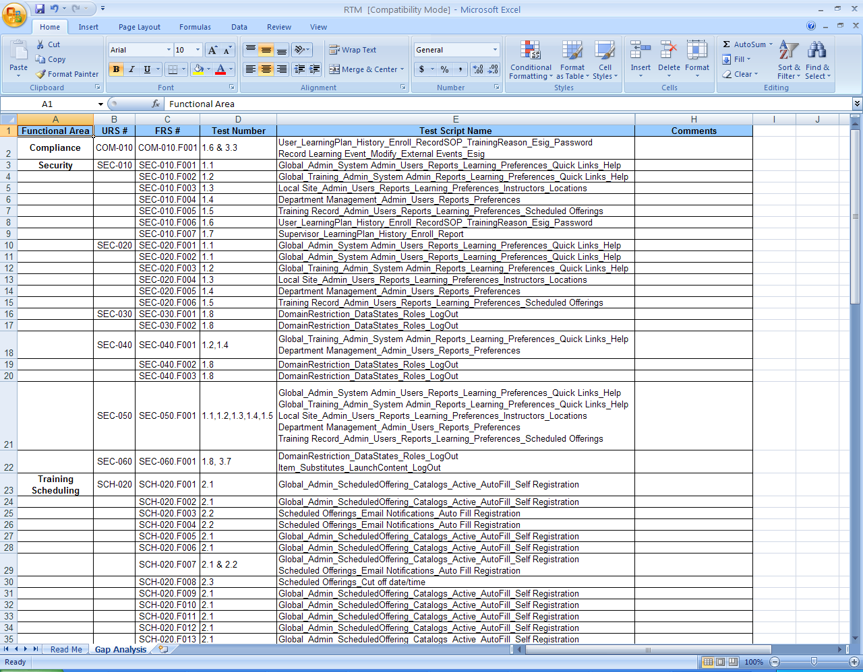
RTM in Spread Sheet
Fig: RTM in Spreadsheet

Slide 102
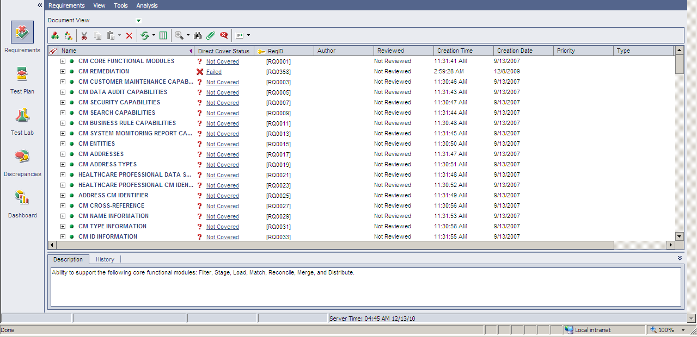
RTM in QC
Fig: RTM in Quality Center

Slide 103
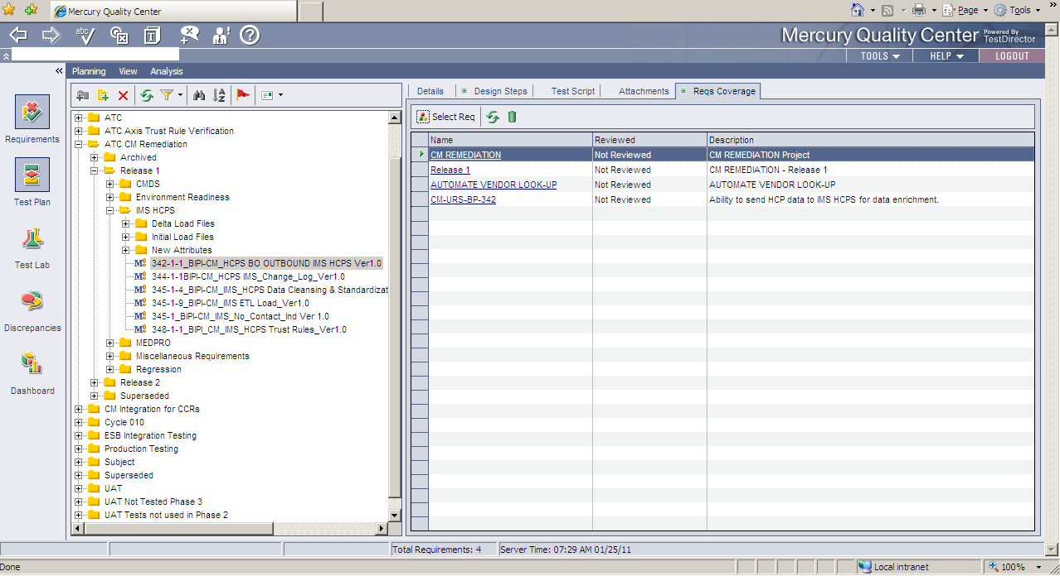
RTM in QC
Fig: RTM in Quality Center

Slide 104
Test Data

Slide 105
Test Data Overview – Test Data
What is Test Data?
The data which have been identified to be used by the testers for testing the various functionality of the application are called Test data
Test Data is to verify that a specific set of inputs are producing some expected result and by doing the same, the function of an application can be tested
The test data may be any kind of input to application, any kind of file that is loaded by the application, or entries read from the database tables
Notes:
Preparing proper test data is part of the test setup.
Generally testers call it as test bed preparation. In test bed all software and hardware requirements are set using the predefined data values.

Slide 106
Test Data Overview – Importance of Test Data
Following are the importance of Test data:
Test Data describes the initial conditions for a test, forms the input, is the medium through which the tester influences the software
Test data is the input feed for testing the application
Good test data assists testing, rather than hinders it
Following are the roles of Test Data in Testing:
A system is programmed by its data
Functional testing suffers if data is poor
Good data is vital to reliable test results
Good data can help testing stay on schedule
Notes:
If you don’t have the systematic approach for building test data while writing and executing test cases then there are chances of missing some important test cases.

Slide 107
Test Data Overview – Importance of Test Data (Contd.)
Poor data can cause the following problems:
Unreliable test results
Poor test data will cause unreliable test results which are wrong and as a result the test run needs to be executed with the correct Test Data to produce accurate test results
Degradation of test data over time
Test Data needs to be reviewed and updated periodically to accommodate all the Change Request happening in the application. Test Data which is not updated periodically will become invalid over a period of time
Reduced flexibility in test execution
Poor test data will not provide flexibility for the testers during execution and might hinder the execution progress
Obscure results and bug reports
Test results and bug reports produced with poor test data might be difficult for the project team to understand the real problem in the application and could result in significant time wastage in analyzing the real problem in the application
Notes:
Sometime it’s not possible to create complete new set of test data for each and every build. In such cases you can use standard production data. But remember to add/insert your own data sets in this available database. One good way to design test data is use the existing sample test data or testbed and append your new test case data each time you get same module for testing. This way you can build comprehensive data set.

Slide 108
Test Data Overview – Importance of Test Data (Contd.)
Larger proportion of problems can be traced to poor data
Defects which are reported by testing team can be rejected by development team with a common reason as poor test data, if the tester fails to use proper test data during testing and produces inaccurate test results and defects
Less time spent hunting bugs
If proper test data are not set before the beginning of testing, then there is a huge chance of spending considerable amount of time to correct the test data during the test execution instead of identifying new defects in the application
Requirements problems can be hidden in inadequate data
Testing with inadequate test data could hide a potential problem in the application or requirements as these data would produce inappropriate results most of the time
Notes:
Sometime it’s not possible to create complete new set of test data for each and every build. In such cases you can use standard production data. But remember to add/insert your own data sets in this available database. One good way to design test data is use the existing sample test data or testbed and append your new test case data each time you get same module for testing. This way you can build comprehensive data set.

Slide 109
Test Data Overview – Test Data Sources
The main source of Test Data is the Test Data Set. The data set can be in Database, CSV, Excel file, XML format or in any format.
Following are Test data set examples:
No data: Run your test cases on blank or default data. See if proper error messages are generated.
Valid data set: Create it to check if application is functioning as per requirements and valid input data is properly saved in database or files.
Invalid data set: Prepare invalid data set to check application behavior for negative values, alphanumeric string inputs.
Illegal data format: Make one data set of illegal data format. System should not accept data in invalid or illegal format. Also check if proper error messages are generated.
Boundary Condition data set: out of range data. Identify application boundary cases and prepare data set that will cover lower as well as upper boundary conditions.
Data set for performance, load and stress testing: This data set should be large in volume.
Notes:
This way creating separate data sets for each test condition will ensure complete test coverage.

Slide 110
Test Data Overview – Organizing the Test Data
A key part of any approach to data is the way the data is organized, chosen and described. It is influenced by the uses that are planned for it.
A good approach increases data reliability, reduces data maintenance time, and can help improve the test process.
Organizing the data helps because of the following reasons:
It improves communication within and outside the team
It reduces test errors caused by using the wrong data
It allows another method of sanity checks for corrupted or inconsistent data
It helps while checking data after input
It helps in selecting data for investigative tests
Notes:
Good data assists testing, rather than hinders it.

Slide 111
Test Data Overview – Classification of Test Data
The following broad categories allow data to be handled and discussed more easily:
Test Data
Environmental data
Setup data
Input Data
Transitional data
Output data
Master
Transaction Data
Fig: Classification of Test Data

Slide 112
Test Data Overview – Classification of Test Data (Contd.)
Environmental data:
Environmental data tells the system about its technical environment.
It includes communication addresses, directory trees and paths, and environmental variables.
The current date and time can be seen as environmental data.
Setup data:
Setup data tells the system about the business rules.
It might include a cross reference between country and delivery cost or method, or methods of debt collection from different kinds of customers.
Following are the two types of Setup data:
Master Data - that seldom changes, such as customer or vendor details and material technical records or part numbers.
Transactional Data - that the system uses during data processing, such as the customer order details or store inventory of part num.
Notes:
With regard to the leave management system described above, below will be examples for each category of test data:
Environmental data: Current system date, since leave accrual is calculated until the current date during which a user applies for leave
Setup data:
Master Data: List of type of leaves handled by the system - vacation leave, sick leave, compensatory off and loss of pay. There are hardly any changes made to this data during the lifetime of the application.
Transactional data: The records of leave taken by the user and the available balance. These data change whenever a leave transaction or a leave accrual happens.
Input data: From date, To date and type of leave entered by the user while applying for leave.

Slide 113
Test Data Overview – Classification of Test Data (Contd.)
Input data:
Input data is the information input by day-to-day system functions.
Accounts, products, orders, actions, and documents can all be input data.
Transitional data:
Transitional data is data that exists only within the program, during the processing of the input data.
Transitional data is not seen outside the system (arguably, test handles and instrumentation make it output data), but its state can be inferred from actions that the system has taken.
Typically held in internal system variables, it is temporary and is lost at the end of processing.
Notes:
Examples (contd.):
Transitional data: Total days of leave taken so far by the user to calculate the available balance. This information is not stored anywhere but calculated from the leave records, stored in temporary variable and deleted after available balance is obtained.
Output data: Available balance for each type of leave at the end of accrual calculation.

Slide 114
Test Data Overview – Classification of Test Data (Contd.)
Output data:
Output data is all the data that a system outputs as a result of processing input data and events.
It generally has a correspondence with the input data, and includes not only files, transmissions, reports, and database updates, but can also include test measurements.
A subset of the output data is generally compared with the expected results at the end of test execution.
As such, it does not directly influence the quality of the tests.
Guidelines for Test Data Preparation are as follows:
Identify the basic set of data which could be reusable.
Prepare test data for both Positive and Negative conditions.
Prepare test data for field level validations.
Prepare test data by applying testing techniques.
Notes:
Examples (contd.):
Transitional data: Total days of leave taken so far by the user to calculate the available balance. This information is not stored anywhere but calculated from the leave records, stored in temporary variable and deleted after available balance is obtained.
Output data: Available balance for each type of leave at the end of accrual calculation.

Slide 115
Test Data Preparation Techniques (Recap)
Boundary Value Analysis
Identify errors at boundaries rather than finding those that exist in center of input domain.
Tests are designed to include representatives of boundary values.
Equivalence Partitioning
Divides the input data of a software unit into partitions of data from which test cases can be derived.
In principle, test cases are designed to cover each partition at least once.
Decision table
A Decision table lists causes and effects in a matrix. Each column represents a unique combination.
Purpose is to structure logic.
Precise yet compact way to model complicated logic.
Cause = condition.
Effect = action = expected results

Slide 116
Test Data Examples
Boundary Value Analysis
The amount field should accept value <= 500. Boundary value analysis will generate the following data:
1. Lower boundary = 499
2. Boundary value = 500
3. Upper Boundary = 501
Equivalence class partitioning
The amount field should accept values from 500 to 1000.
As per the equivalence class there are valid class and Invalid class. Take a value from each of the class to test. The data can be as follows:
Invalid class 1: any value less than 500.
For example, 0,1,40, 400.
Invalid class 2: any value greater then 1000
For example, 1200, 10050, and 1500.
Valid class: Any value between 500 - 1000.

Slide 117
Test Data Examples (Contd.)
Null/Not Null checks
Leave the mandatory field blank and proceed.
Leave the non-mandatory field blank and proceed.
Uniqueness Checks
Check if the generated employee ID is unique.
Check if duplicate product code can be added.
Check if system adds duplicate item code.
Length Checks
Name should be of minimum three characters and maximum 30 characters then the following will be length checks:
Check for minimum character: “KP”
Check for maximum character: “This is to test Maximum Character”
Numeric Checks
The No of Units field should accept only numeric value. The test data will be as follows:
0.0145, 0, 1A001, and so on

Slide 118
Test Data Examples (Contd.)
Negative Checks
Select data that the system is not supposed to accept.
Check for –2, -0.876
Default Display
Punch in the customer number and verify the customer details.
Check the default selection of Radio button.
Check the default selection from the drop down list box.
Check the default display in Home page and other pages.
Date Range Checks
Start date: 01/20/2005; End date: 01/21/2005
Start date: 01/20/2005; End date: 01/19/2005
Check for Leap year - 02/ 29/2005
Check for invalid date - 02/30/2005
Check for date in invalid format - 30/02/2005

Slide 119
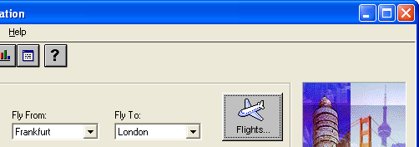
Test Data Example (Contd.)
Let us assume the following:
1. The “Flights” button would function only if the values are selected from the dropdown lists.
2. “Fly From” dropdown list would have three values like Frankfurt, Colombo, Austin, and a blank value.
3. “Fly To” dropdown list would have three values like Paris, London, Delhi, and a blank value.
Generate Test Data for the above example

Slide 120
Test Data Example (Contd.)
The ideal set of test data for the flight example is as follows:
Sl. no. | Fly From | Fly To | Action Pass/Fail
1 | Not Selected | Not Selected | Fail
2 | Not Selected | Selected Paris | Fail
3 | Not Selected | Selected London | Fail
4 | Not Selected | Selected Delhi | Fail
5 | Selected Frankfurt | Not Selected | Fail
6 | Selected Frankfurt | Selected Paris | Pass
7 | Selected Frankfurt | Selected London | Pass
8 | Selected Frankfurt | Selected Delhi | Pass
9 | Selected Colombo | Not Selected | Fail

Slide 121
Test Data Example (Contd.)
(Contd...)
Sl. no. | Fly From | Fly To | Action Pass/Fail
10 | Selected Colombo | Selected Paris | Pass
11 | Selected Colombo | Selected London | Pass
12 | Selected Colombo | Selected Delhi | Pass
13 | Selected Austin | Not Selected | Fail
14 | Selected Austin | Selected Paris | Pass
15 | Selected Austin | Selected London | Pass
16 | Selected Austin | Selected Delhi | Pass

Slide 122
Test Runs
Test Runs are the grouping of test cases for execution
Test runs helps to:
Define the test execution flow
Setting the test properties
Defining the hierarchy of test cases for execution
As a result of the Test Development, the complete suite of Test Cases for a particular Application/Functionality is created
Following are the necessity of Test Runs:
Aids in understanding the pattern and order of testing
Defines the Priority of Test Cases
Notes:
Test Runs:
Defining test execution flow.
Setting the test properties.
Defining the hierarchy of test cases

Slide 123
Building Test Runs
The grouping of test cases to create the test runs are based on the following factors:
Functionalities that are being tested in a build.
Dependencies between test cases.
Test Scenarios based grouping.
Prioritization of test cases.
The test data is also embedded with the test cases. Also, test results can be stored in the Test runs.
Notes:
The grouping of test cases to create the test runs are based on various factors, mentioned below:
Functionalities that are being tested in a build.
Dependencies between test cases ( for instance, if a test case is dependent on the results of another, then each of them are grouped to different Test cycles).
Grouping of similar functionality based on the Test Scenarios (for instance, if there are a number of test cases, that are derived from a single test scenario, these can be grouped to a test run.
Prioritization of test cases.
The test data is also embedded with the test cases and also test results can be stored in the Test runs.

Slide 124
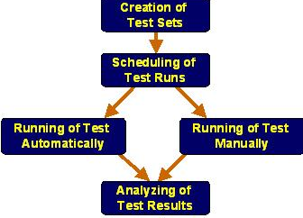
Flow of Test Execution
Fig: Test Execution Flow

Slide 125
Creation of Test Sets
A test set is a group of tests in a Quality Center project designed for achieving some particular testing objectives.
The process begins with the identification of all the end-to-end scenarios, followed by creation of individual test Sets for every such end-to-end scenario.
After creating the test sets, tests set folders are created and assigned to development and QA cycles based on the project timeline.
Notes:
Creation of Test Sets:
A test set is a group of tests in a Quality Center project designed for achieving some particular testing objectives.
The process begins with the identification of all the end-to-end scenarios, followed by creation of individual test Sets for every such end-to-end scenario.
After creating the test sets, tests set folders are created and assigned to development and QA cycles based on the project timeline.

Slide 126
Scheduling Test Runs
Quality Center enables us to control the execution of tests in a test set.
We can set conditions and schedule the date and time for executing our tests.
We can define the sequence in which to execute the tests.
For example, we can define to run "test2" only when "test1" has finished, and run "test3" only if "test1" has passed.
Notes:
Scheduling Test Runs:
Quality Center enables us to control the execution of tests in a test set.
We can set conditions, and schedule the date and time for executing our tests.
We can define the sequence in which to execute the tests. For example, we can define to run "test2" only when "test1" has finished, and run "test3" only if "test1" has passed.

Slide 127
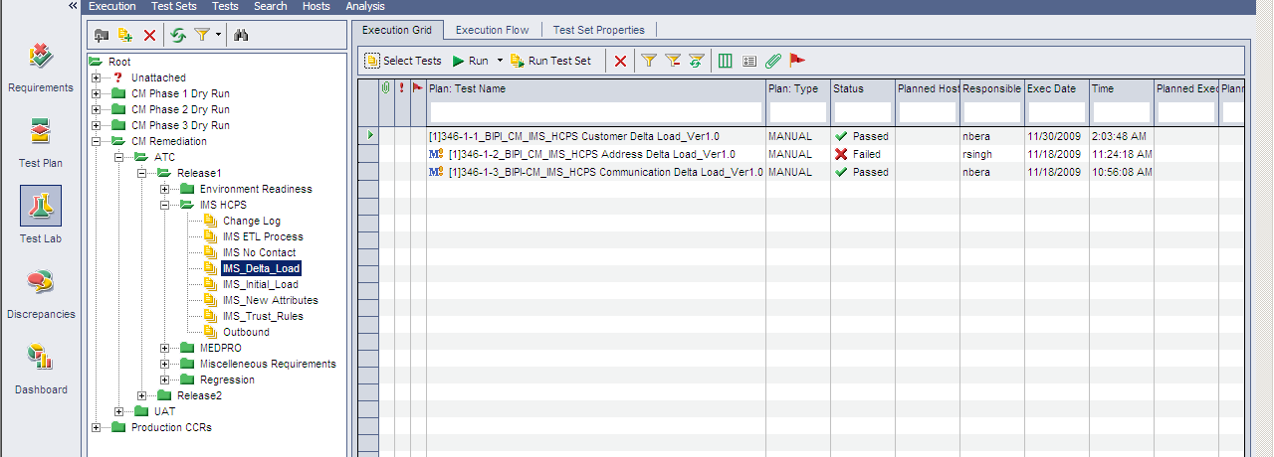
Test Runs in QC
Fig: Test Runs in Quality Center

Slide 128
Test Design: Comparison ‘Application Development’ Vs ‘Application Maintenance’
 | Test Scenario | Test Case
Application Development | Use all requirement documents Create Test Scenarios for the complete set of requirements Test Scenarios will be created for the end-end functionalities Review will happen for all the created Test Scenarios More rigor on test scenario development | Test Cases will be created fresh for all the functionalities Create new Test Cases for all the identified Test Scenarios Review will happen for all the created Test Cases Create Test Data for all the newly created Test Cases
Application Maintenance | Use Change Request (CR) and updated requirement documents Create and review Test Scenarios for only the CR (Change Request) or enhancement based upon the Impact Analysis Test scenarios may not be created for smaller changes and bug fixes Update existing Test Scenarios based upon the CR Impact Analysis. Not done for scenarios which are not impacted by the CR | Create new Test Cases for the newly created Test Scenarios Update existing Test Cases which require changes based upon the CR Impact Analysis Need not update the existing Test Cases which doesn’t have any CR Impact Need not review all the Test Cases Review will happen for only the newly created and updated Test Cases having CR Impact Test data is identified from the existing production data

Slide 129
Test Design: Comparison ‘Application Development’ Vs ‘Application Maintenance’ (Contd.)
 | Regression | RTM
Application Development | Most of the progression test cases are executed during every cycle of testing for regression. More focus towards defect re-test related regression Automation of regression test cases is less as the regression tests are dependent on the defect fixes and hence re-use is lesser | Establish RTM for the entire project from scratch RTM will have coverage for all the testable requirements from the requirement document Review will happen for the entire RTM
Application Maintenance | Regression is focused more on the critical functionalities of the base application rather than the new changes/enhancements. More structured process towards incremental addition to the base regression suite after every release. Regression test cases are mostly automated due to the high re-use release after release | Establish RTM for only the CR Impact Update the RTM with only the new/modified Test Cases Review will happen for only the updated portion in the RTM

Slide 130
Allow time for questions from participants

Slide 131
Test Your Understanding
List the activities involved in the Test Design Process
What are the various components of a Test case?
List the steps involved in the review process of a test case document.
What are the factors that influence the selection of the regression test cases?
What are the various types of test data?

Slide 132
Fundamentals of Test Design: Summary
The Test Design process involves the following activities:
Obtain the Test Basis (such as requirements, architecture, design, interfaces) for Test Design
Perform functional decomposition of the Requirements
Develop Test Scenarios
Review Test Scenarios
Identify Test Condition
Develop Test Cases for the derived Test Scenarios
Review Test Cases
Prepare Traceability Matrix
Prepare Test Data to support the Test conditions and Test cases
Perform Impact analysis and Identify regression test cases
Create Test Run plan
Notes:
This slide lists the summary of the various point covered in the Module. This slide also presents you the opportunity to clarify learners questions.
Dos:
List the main points presented in the module.
Restate Objective and Importance of the Module.
If any scenario was used in the overview, conclude the scenario in the summary slide.
Don’ts:
Try to keep the text count to 100 words

Slide 133
Fundamentals of Test Design: Summary Contd.,
Test Scenario is a sequence of realistic events that would occur in the actual business scenario using the application under test
Test scenarios can be categorized as follows:
Basic flow - Scenarios aimed to ensure that the application attains it’s prime objective or function. This also covers the Scenarios aimed at showing how the application does not do what it is not supposed to do.
Alternate - Scenarios generated to achieve the goal by following an alternate workflow
Exception - Scenarios generated to test the application behavior under exception conditions
Following are the components of Test Scenarios:
Scenario #
Scenario Description
Sequence of events/activities
Reference document
Requirement ID/Use case name
Test Scenarios could be generated using the following techniques:
Use Case Modeling
Activity Component Element

Slide 134
Fundamentals of Test Design: Summary Contd.,
Test Scenarios could be generated using the following techniques:
Use Case Modeling
Activity Component Element
Test Case is a set of inputs, execution preconditions, and expected outcomes developed for a particular objective, such as to exercise a particular program path or to verify compliance with a specific requirement.
Test case is a one that has a high probability to find an error
Test cases help to discover information
Test cases must be written for the invalid and the unexpected, as well as for valid and expected conditions
Test case should not be redundant and neither too simple nor too complex (more than one expected result)
Following are the steps to arrive at test cases:
From the scenarios, the basic and alternate flows could be considered to write the test cases. Thus, multiple test cases could be generated for a single scenario with multiple test conditions. Both positive and negative test cases can be derived for a single scenario.

Slide 135
Fundamentals of Test Design: Summary Contd.,
Identify test conditions as follows:
For each flow, identify the input variables for each step. Input variables are the parameters that the user provides as input.
Find out the significantly different options for each of the input variables.
Identify the various possible combinations of the above options.
Combine test conditions along with the identified scenarios to be tested into test cases.
Decide on whether to combine or split the test cases for each of the different flows (basic, alternate).
Following are the components of Test Case:
Test Case ID
Test Case
Pre-Requisites
Steps to Execute the Test case
Test Data
Expected Results
Actual Results
PASS/FAIL
Defect ID
Remarks
Notes:
This slide lists the summary of the various point covered in the Module. This slide also presents you the opportunity to clarify learners questions.
Dos:
List the main points presented in the module.
Restate Objective and Importance of the Module.
If any scenario was used in the overview, conclude the scenario in the summary slide.
Don’ts:
Try to keep the text count to 100 words

Slide 136
Fundamentals of Test Design: Summary Contd.,
System Test cases are designed to test the behavior of a whole system/product as defined by the scope of a development project
System testing may include tests based on the following:
risks and/or on requirements specifications
business processes
use cases
other high level descriptions of system behavior
interactions with the operating system and system resources
Notes:
This slide lists the summary of the various point covered in the Module. This slide also presents you the opportunity to clarify learners questions.
Dos:
List the main points presented in the module.
Restate Objective and Importance of the Module.
If any scenario was used in the overview, conclude the scenario in the summary slide.
Don’ts:
Try to keep the text count to 100 words

Slide 137
Fundamentals of Test Design: Summary Contd.,
System Test cases are designed to test the behavior of a whole system/product as defined by the scope of a development project
System testing may include tests based on the following:
risks and/or on requirements specifications
business processes
use cases
other high level descriptions of system behavior
interactions with the operating system and system resources
Component integration test cases are written to test the interactions between software components and is done after component testing.
System integration test cases are written to test the interactions between different systems and may be done after system testing.
Notes:
This slide lists the summary of the various point covered in the Module. This slide also presents you the opportunity to clarify learners questions.
Dos:
List the main points presented in the module.
Restate Objective and Importance of the Module.
If any scenario was used in the overview, conclude the scenario in the summary slide.
Don’ts:
Try to keep the text count to 100 words

Slide 138
Fundamentals of Test Design: Summary Contd.,
Following are a few Test Design techniques
Equivalence Partitioning
Boundary Value Analysis
Decision Table
Following are the two types of review:
Self Review
Peer Review
Regression testing is carried out for the following reasons:
To uncover software errors after changes to the program.
To assure that a change, such as a bug fix, did not introduce new bugs.
To test the system efficiently by systematically selecting the appropriate minimum suite of tests.
Notes:
This slide lists the summary of the various point covered in the Module. This slide also presents you the opportunity to clarify learners questions.
Dos:
List the main points presented in the module.
Restate Objective and Importance of the Module.
If any scenario was used in the overview, conclude the scenario in the summary slide.
Don’ts:
Try to keep the text count to 100 words

Slide 139
Fundamentals of Test Design: Summary Contd.,
Set of test scenarios and test cases are designed to ensure that software is accurate and correct after undergoing corrections or changes.
Based on the impact caused to the system, test suites are created and prioritized.
One of the effective method is to categorize all functional tests based on functionality. From each category select the minimum number of tests to be rolled into regression suite. Selection should be based on the following:
All tests which cover multiple functionalities
All tests which cover critical functionalities
All Boundary value test cases
Some of the positive test cases
Some of the negative test cases
The process of understanding the complete effect of a particular change in order to determine how this change will impact the testing process is known as impact analysis
Notes:
This slide lists the summary of the various point covered in the Module. This slide also presents you the opportunity to clarify learners questions.
Dos:
List the main points presented in the module.
Restate Objective and Importance of the Module.
If any scenario was used in the overview, conclude the scenario in the summary slide.
Don’ts:
Try to keep the text count to 100 words

Slide 140
Fundamentals of Test Design: Summary Contd.,
Impact analysis is required during the following instances:
Testing after Bug fixing
Change to the requirements
Change request is introduced to the product
Introducing a new module or functionality to an existing product under test
The data which have been identified to be used by the testers for testing the various functionality of the application are called Test data
The following broad categories allow data to be handled and discussed more easily:
Environmental data
Setup data
Master Data
Transactional Data
Input data
Output data
Notes:
This slide lists the summary of the various point covered in the Module. This slide also presents you the opportunity to clarify learners questions.
Dos:
List the main points presented in the module.
Restate Objective and Importance of the Module.
If any scenario was used in the overview, conclude the scenario in the summary slide.
Don’ts:
Try to keep the text count to 100 words

Slide 141
Fundamentals of Test Design: Summary Contd.,
Test Runs are the grouping of test cases for execution
The grouping of test cases to create the test runs are based on the following factors:
Functionalities that are being tested in a build.
Dependencies between test cases.
Test Scenarios based grouping.
Prioritization of test cases.
A test set is a group of tests in a Quality Center project designed for achieving some particular testing objectives.

Slide 142
Sources
Websites:
www.qai.com
www.softwareqatest.com
www.qualityworld.com
Books:
ISTQB. Certified Tester – Foundation Level Syllabus. Version 2007
William E Perry. CSTE Common Body of Knowledge. QAI, 2006
Cognizant Academy. Software Testing. Cognizant Technology Solutions, 2004
Disclaimer: Parts of the content of this course is based on the materials available from the Web sites and books listed above. The materials that can be accessed from linked sites are not maintained by Cognizant Academy and we are not responsible for the contents thereof. All trademarks, service marks, and trade names in this course are the marks of the respective owner(s).

Slide 143
You have completed the Fundamentals of Test Design
Session.
Notes:
Enter the course title.
Enter the knowledge level that will be addressed through this course.

